Slide 1
Aviation accidents Visualization project
Group 3 members:
Arame diasse, Jackie ochuida, Nicholas George, Rajib maji, Stephen grantham, Theresa bravo, Vishnu pillai

Slide 2
Aviation Accidents' visualization
Introduction:
QUESTIONS TO BE CONSIDERED:
Can we accurately predict where plane crashes are about to occur?
Are there certain airlines that have more crashes than others?
Are there possible outside factors affecting these trends?

Slide 3

Aviation Accidents visualization
Extraction +
Transformation:

Slide 4
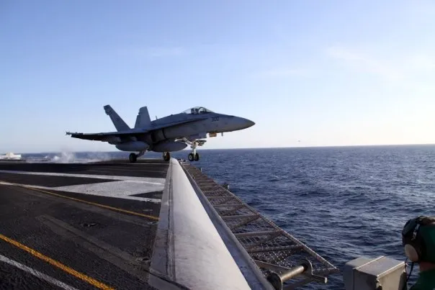
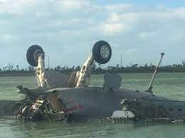
Aviation Accidents visualization
Extraction +
Transformation:
Data Extraction
Web Scraping
Text Parsing
Modules/APIs
Data Transformation
Removal of Unwanted Information
Old/New Names
Standardization

Slide 5
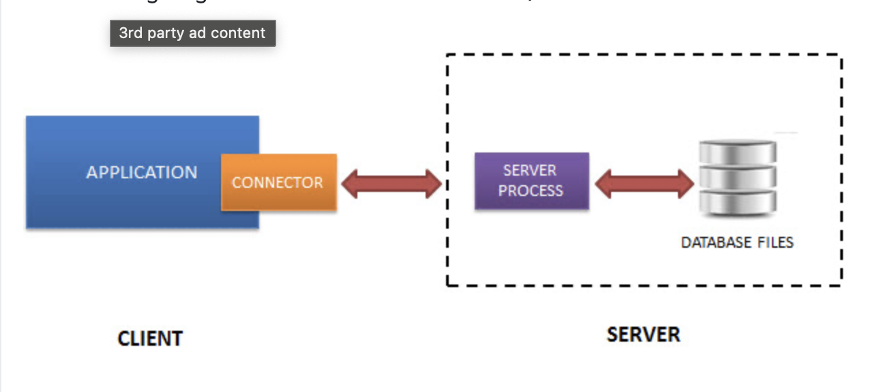
Aviation Accidents visualization
Flask API / SQLite
Database
Loading:

Slide 6
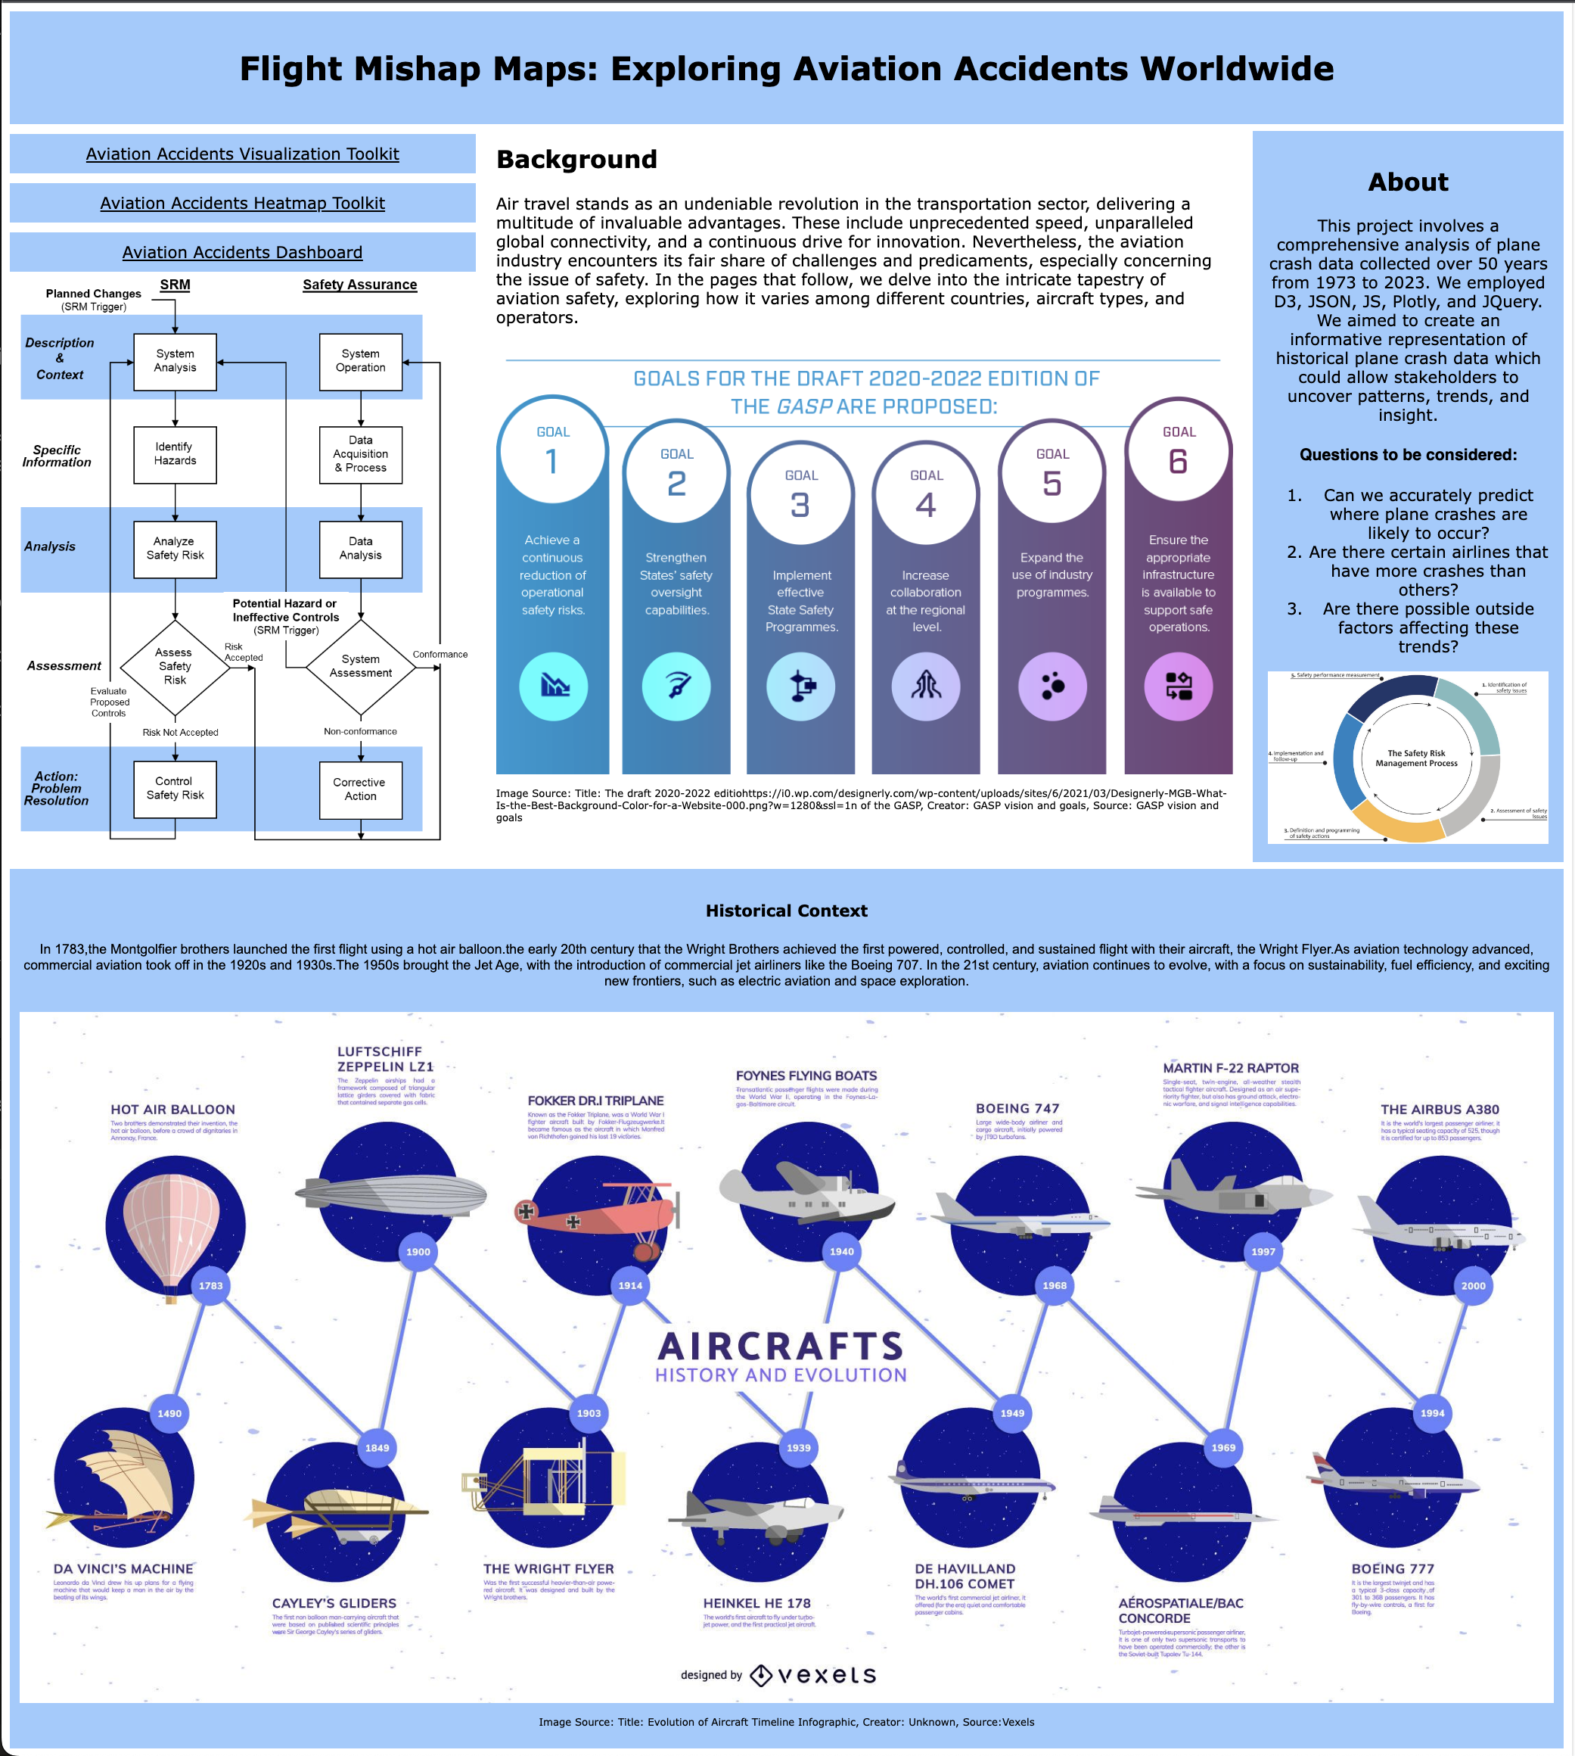
Aviation Accidents Visualization
Landing Page:

Slide 7
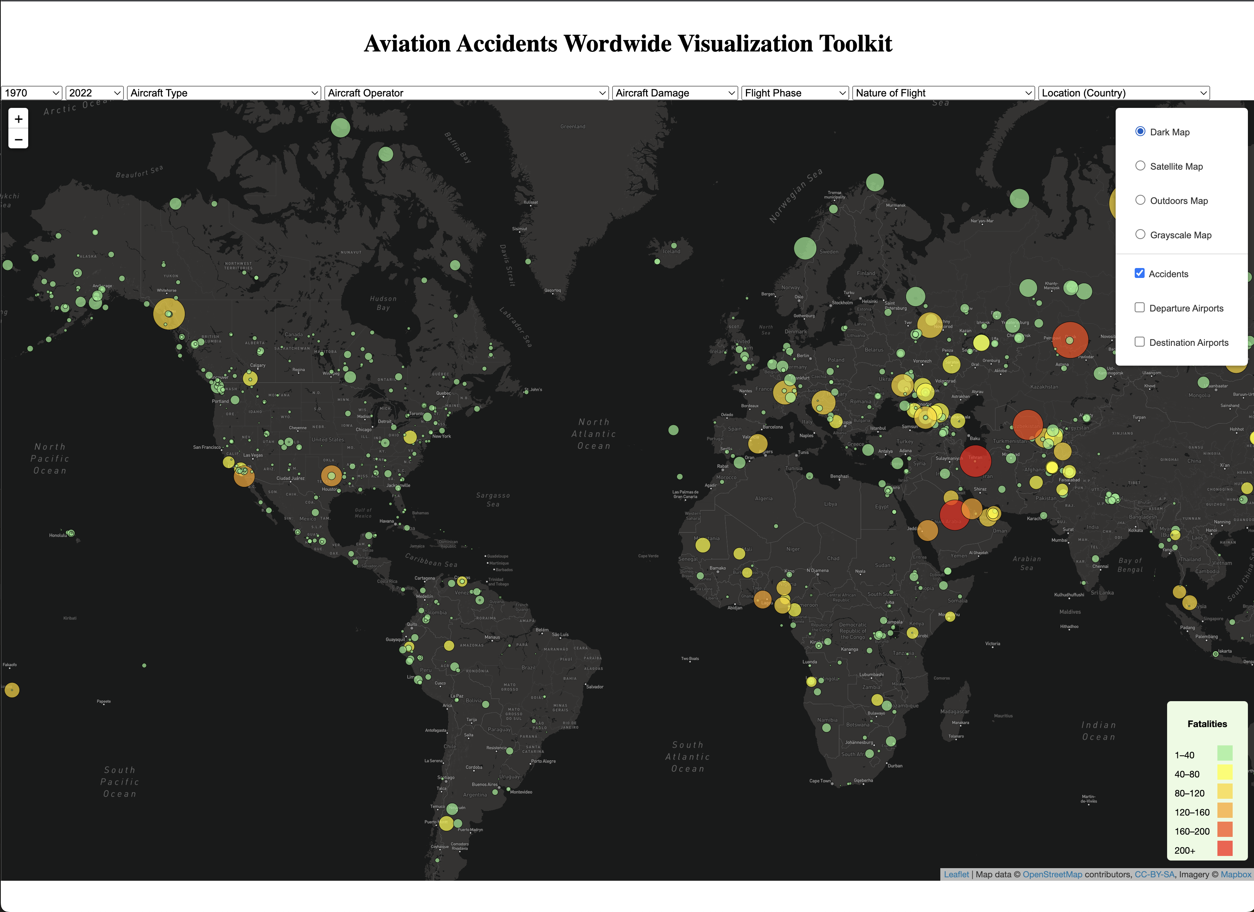
Aviation Accidents Visualization
Visualization:

Slide 8
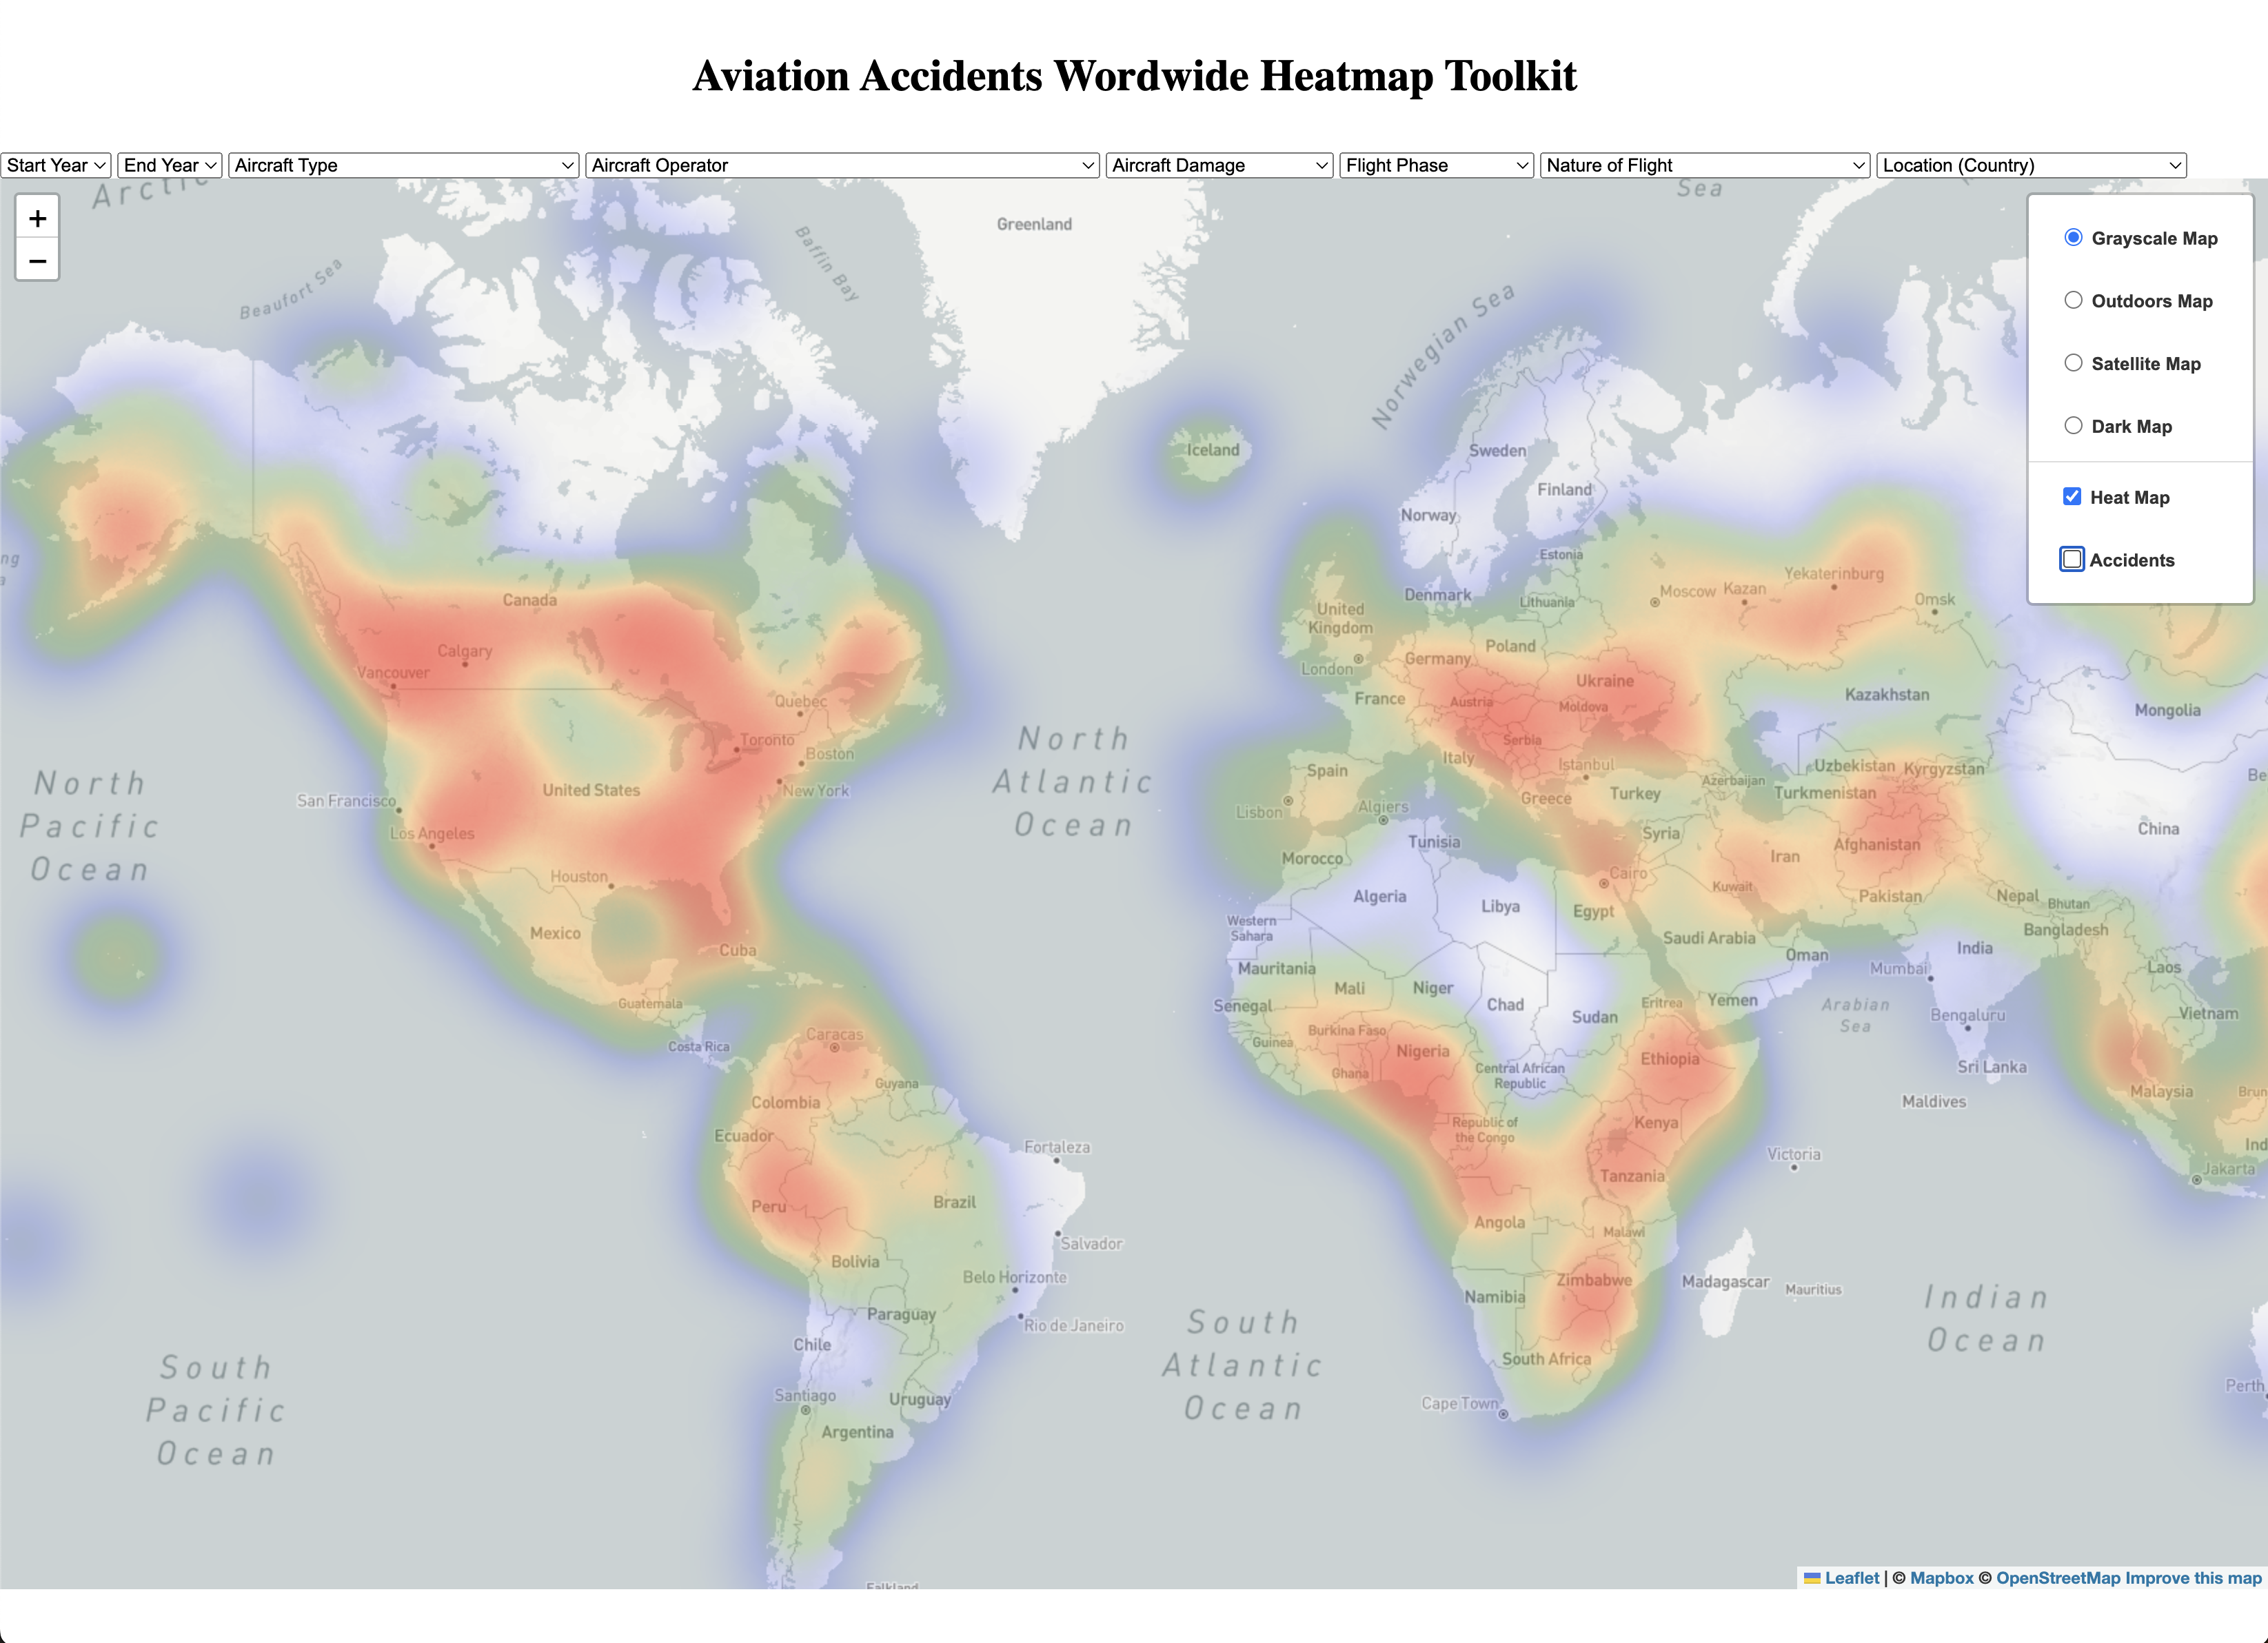
Aviation Accidents Visualization
Heatmap:

Slide 9
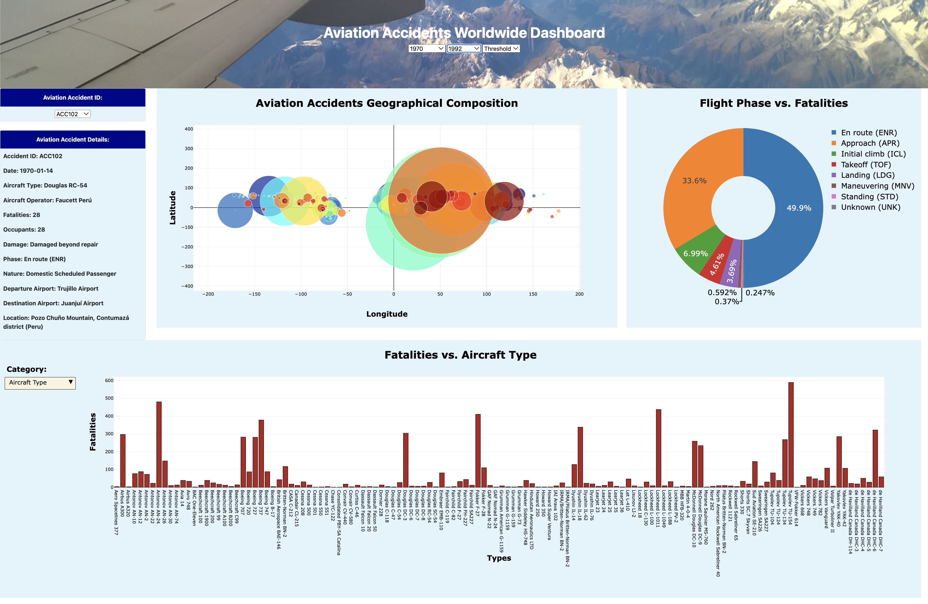
Aviation Accidents Visualization
Dashboard:

Slide 10
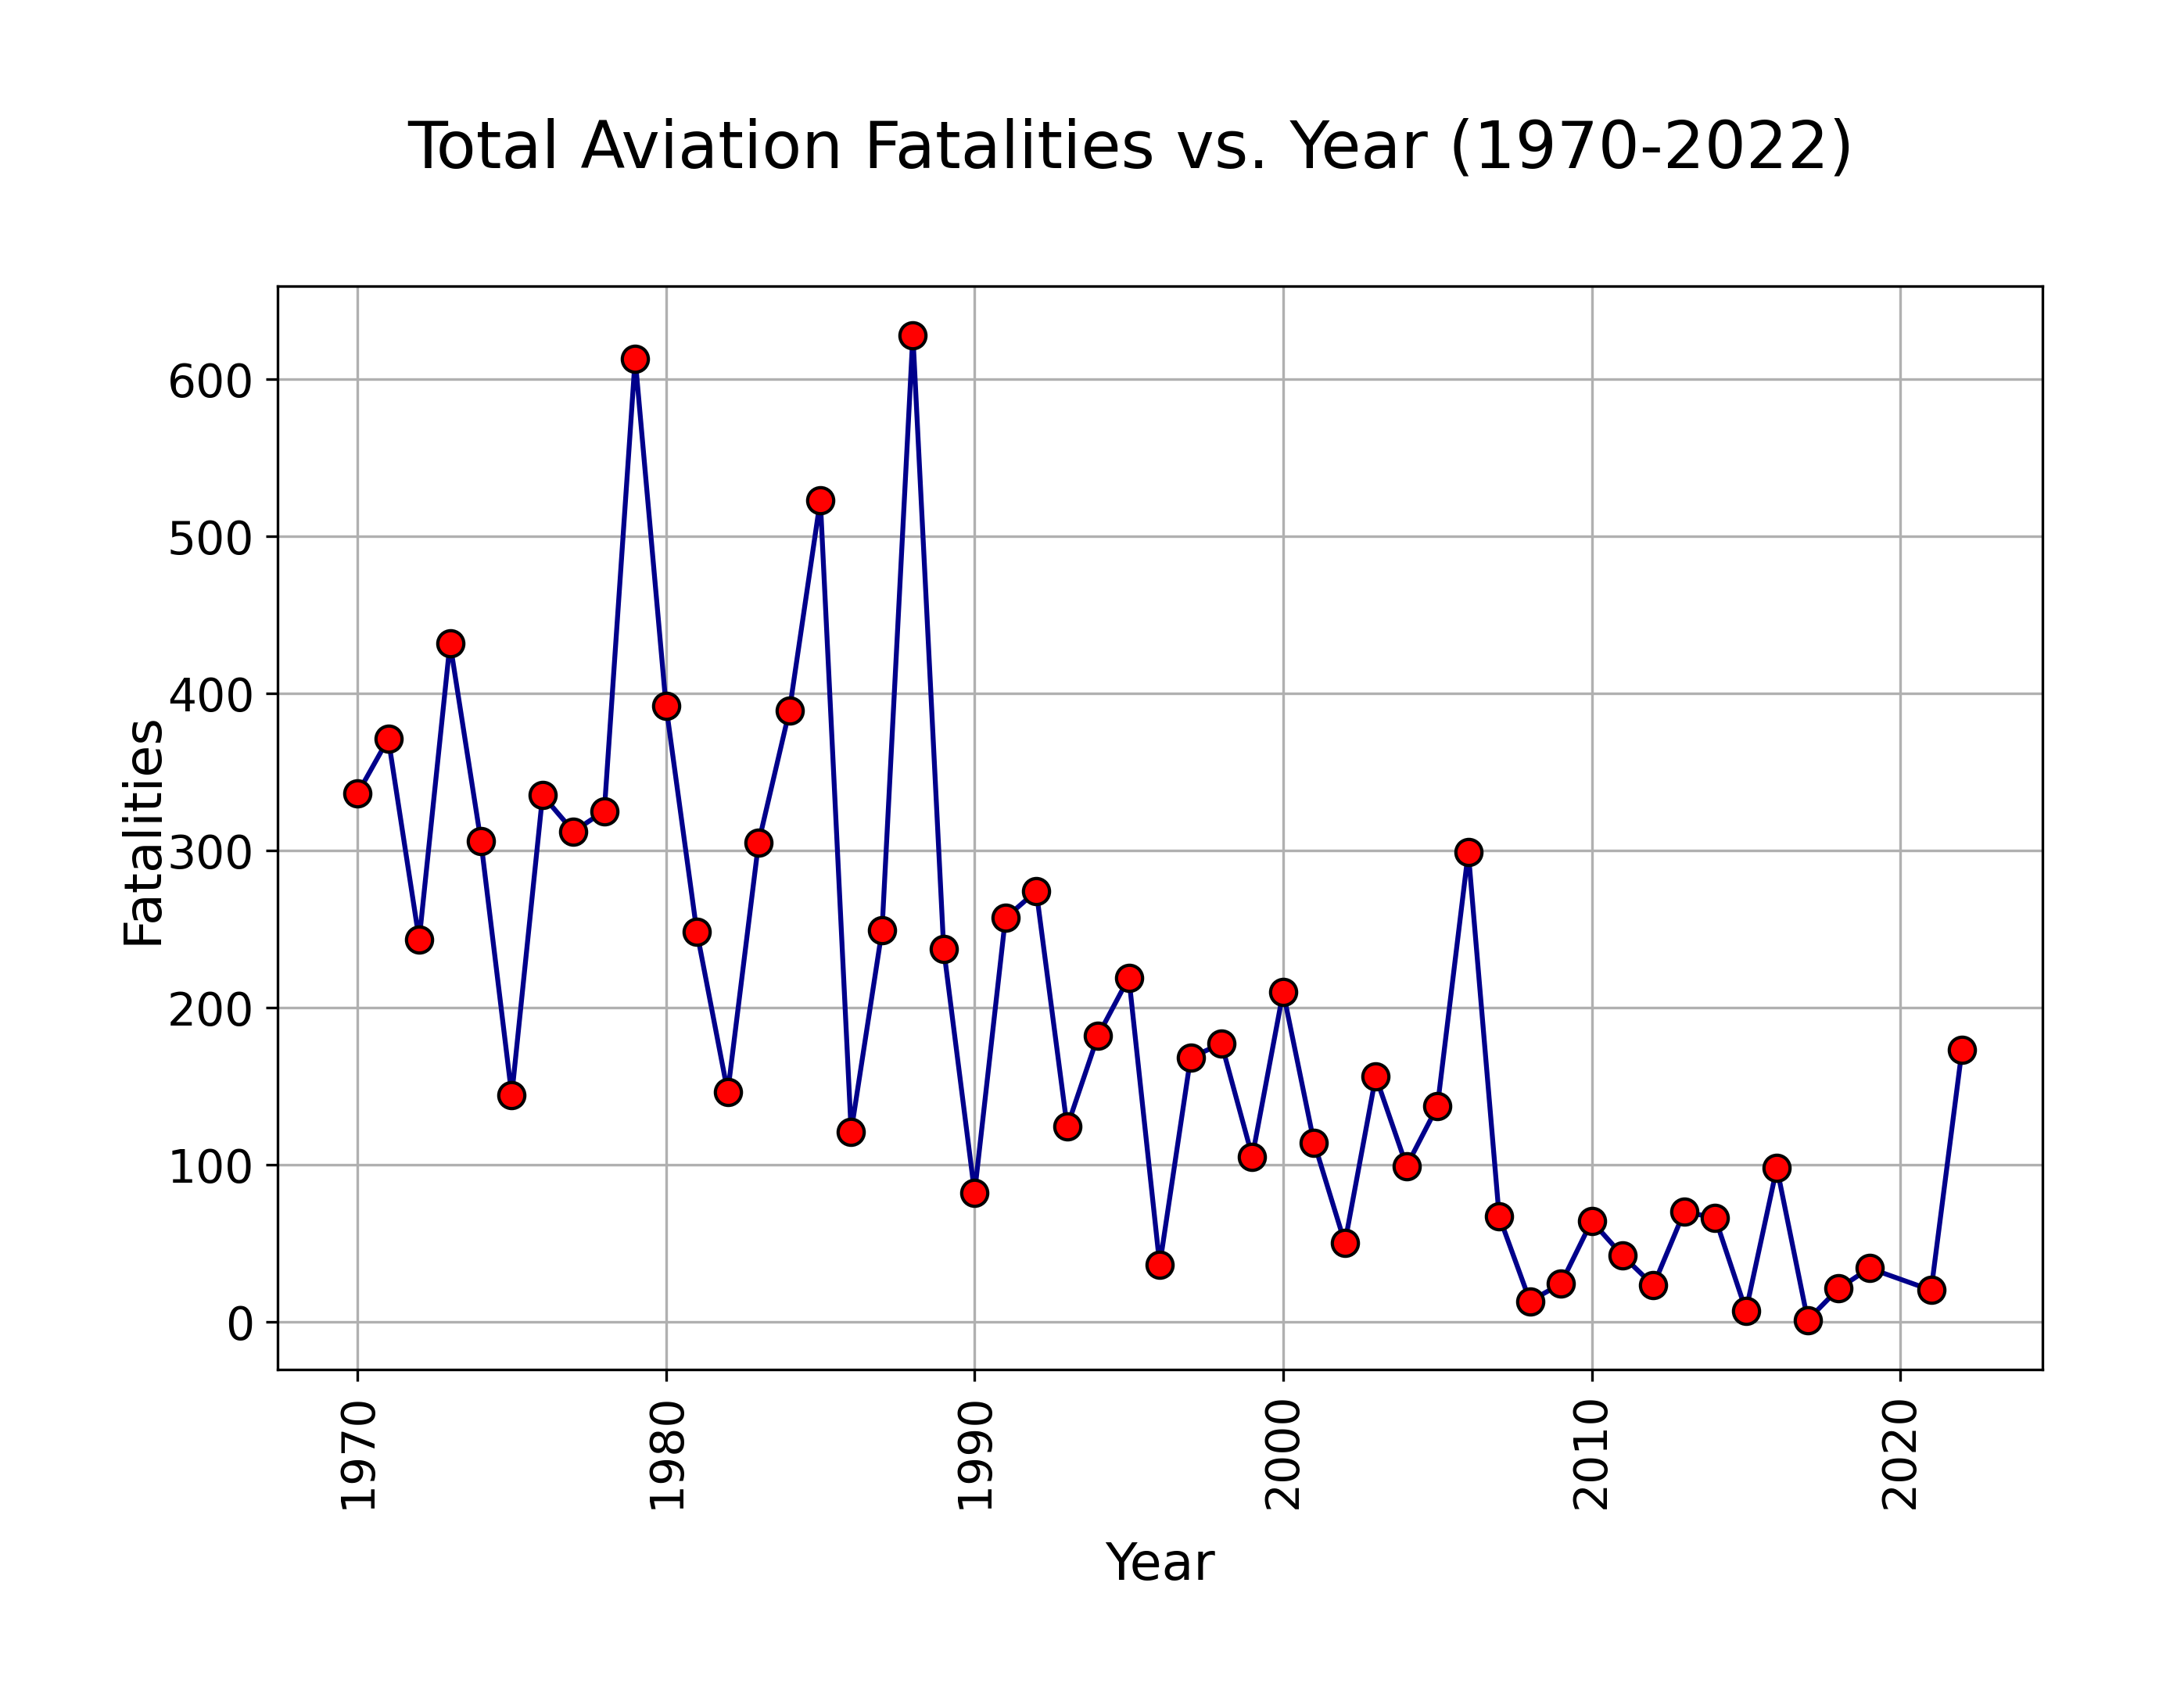
Aviation Accidents Visualization
Analysis:

Slide 11
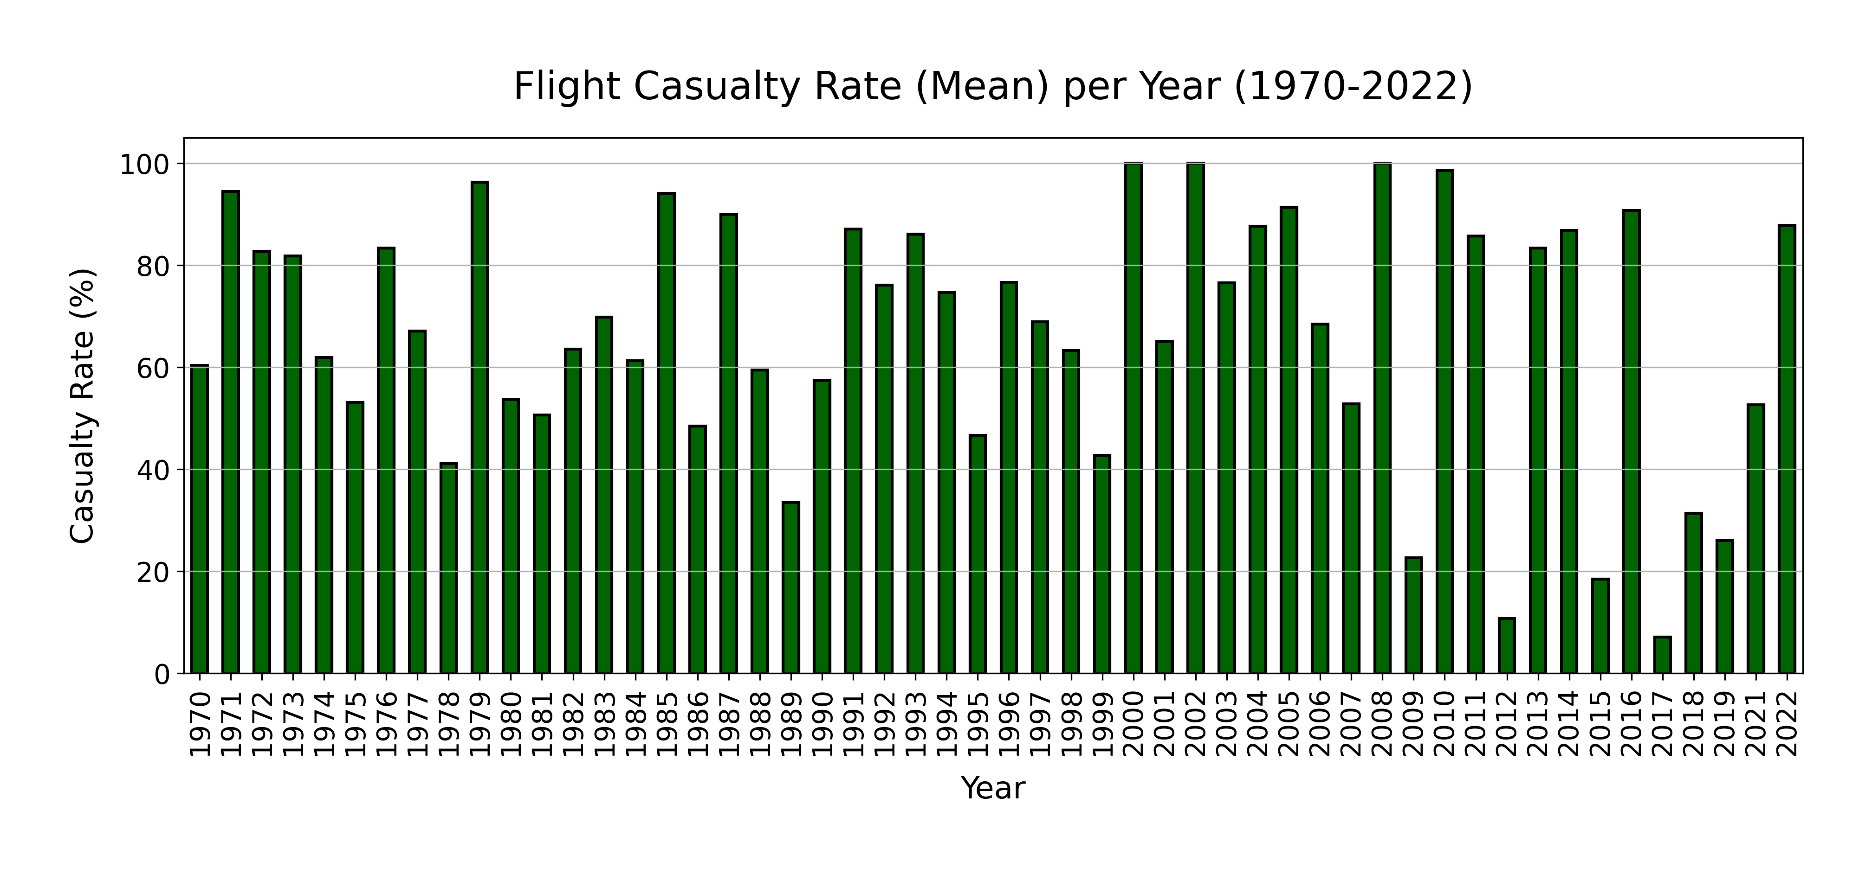
Aviation Accidents Visualization
Analysis:

Slide 12
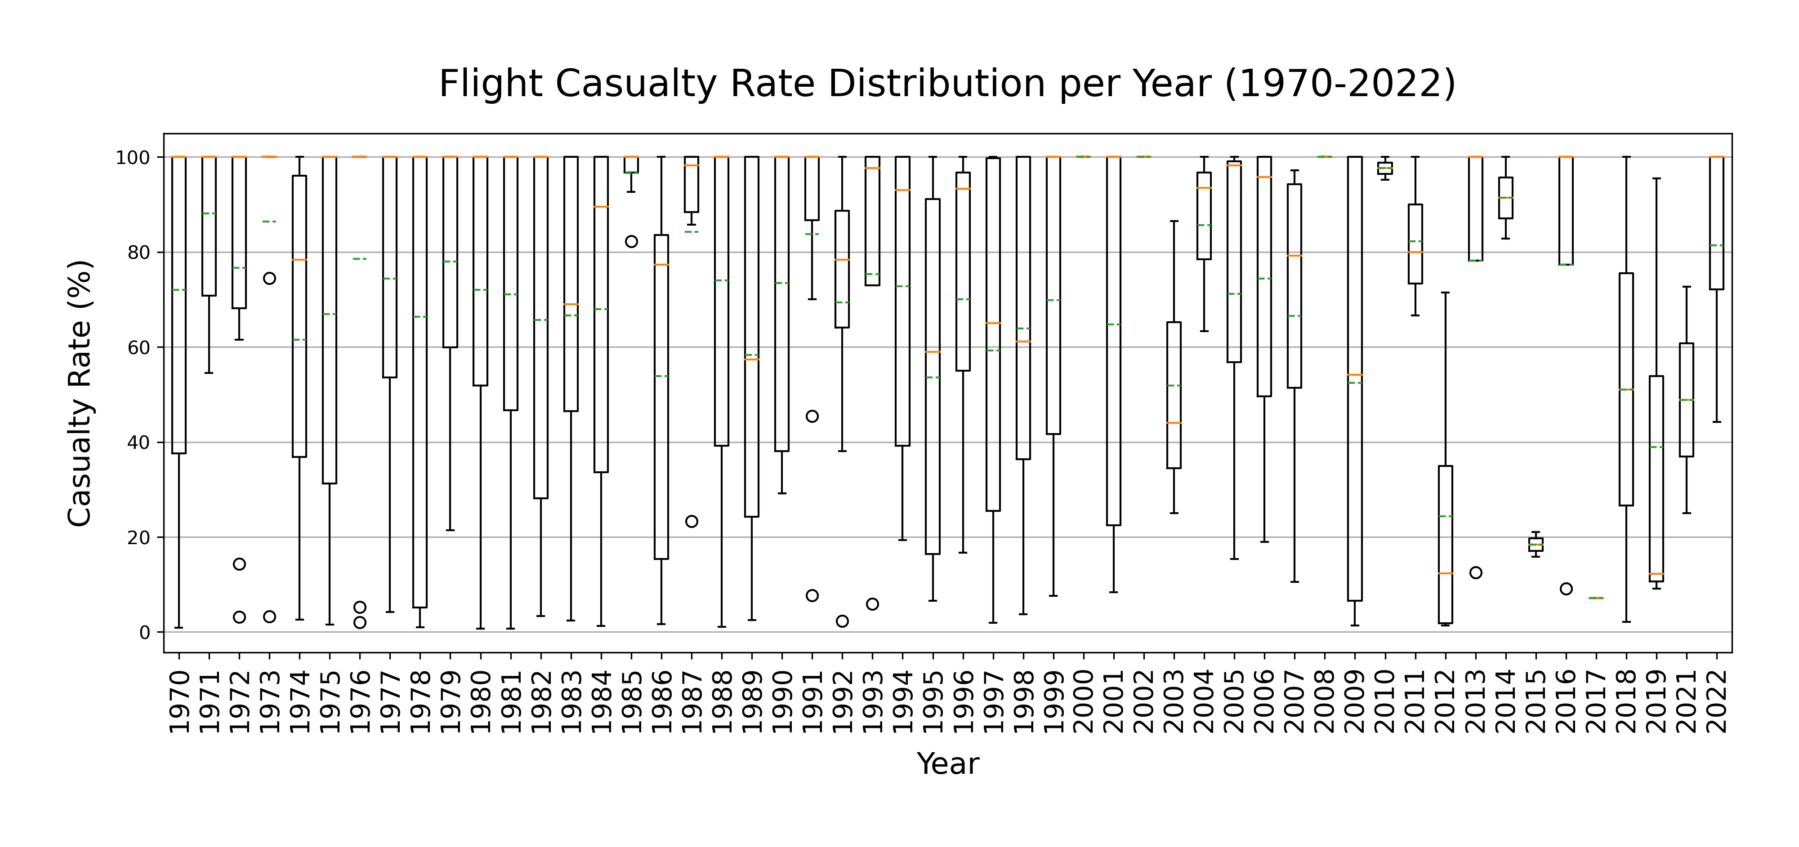
Aviation Accidents Visualization
Analysis:

Slide 13
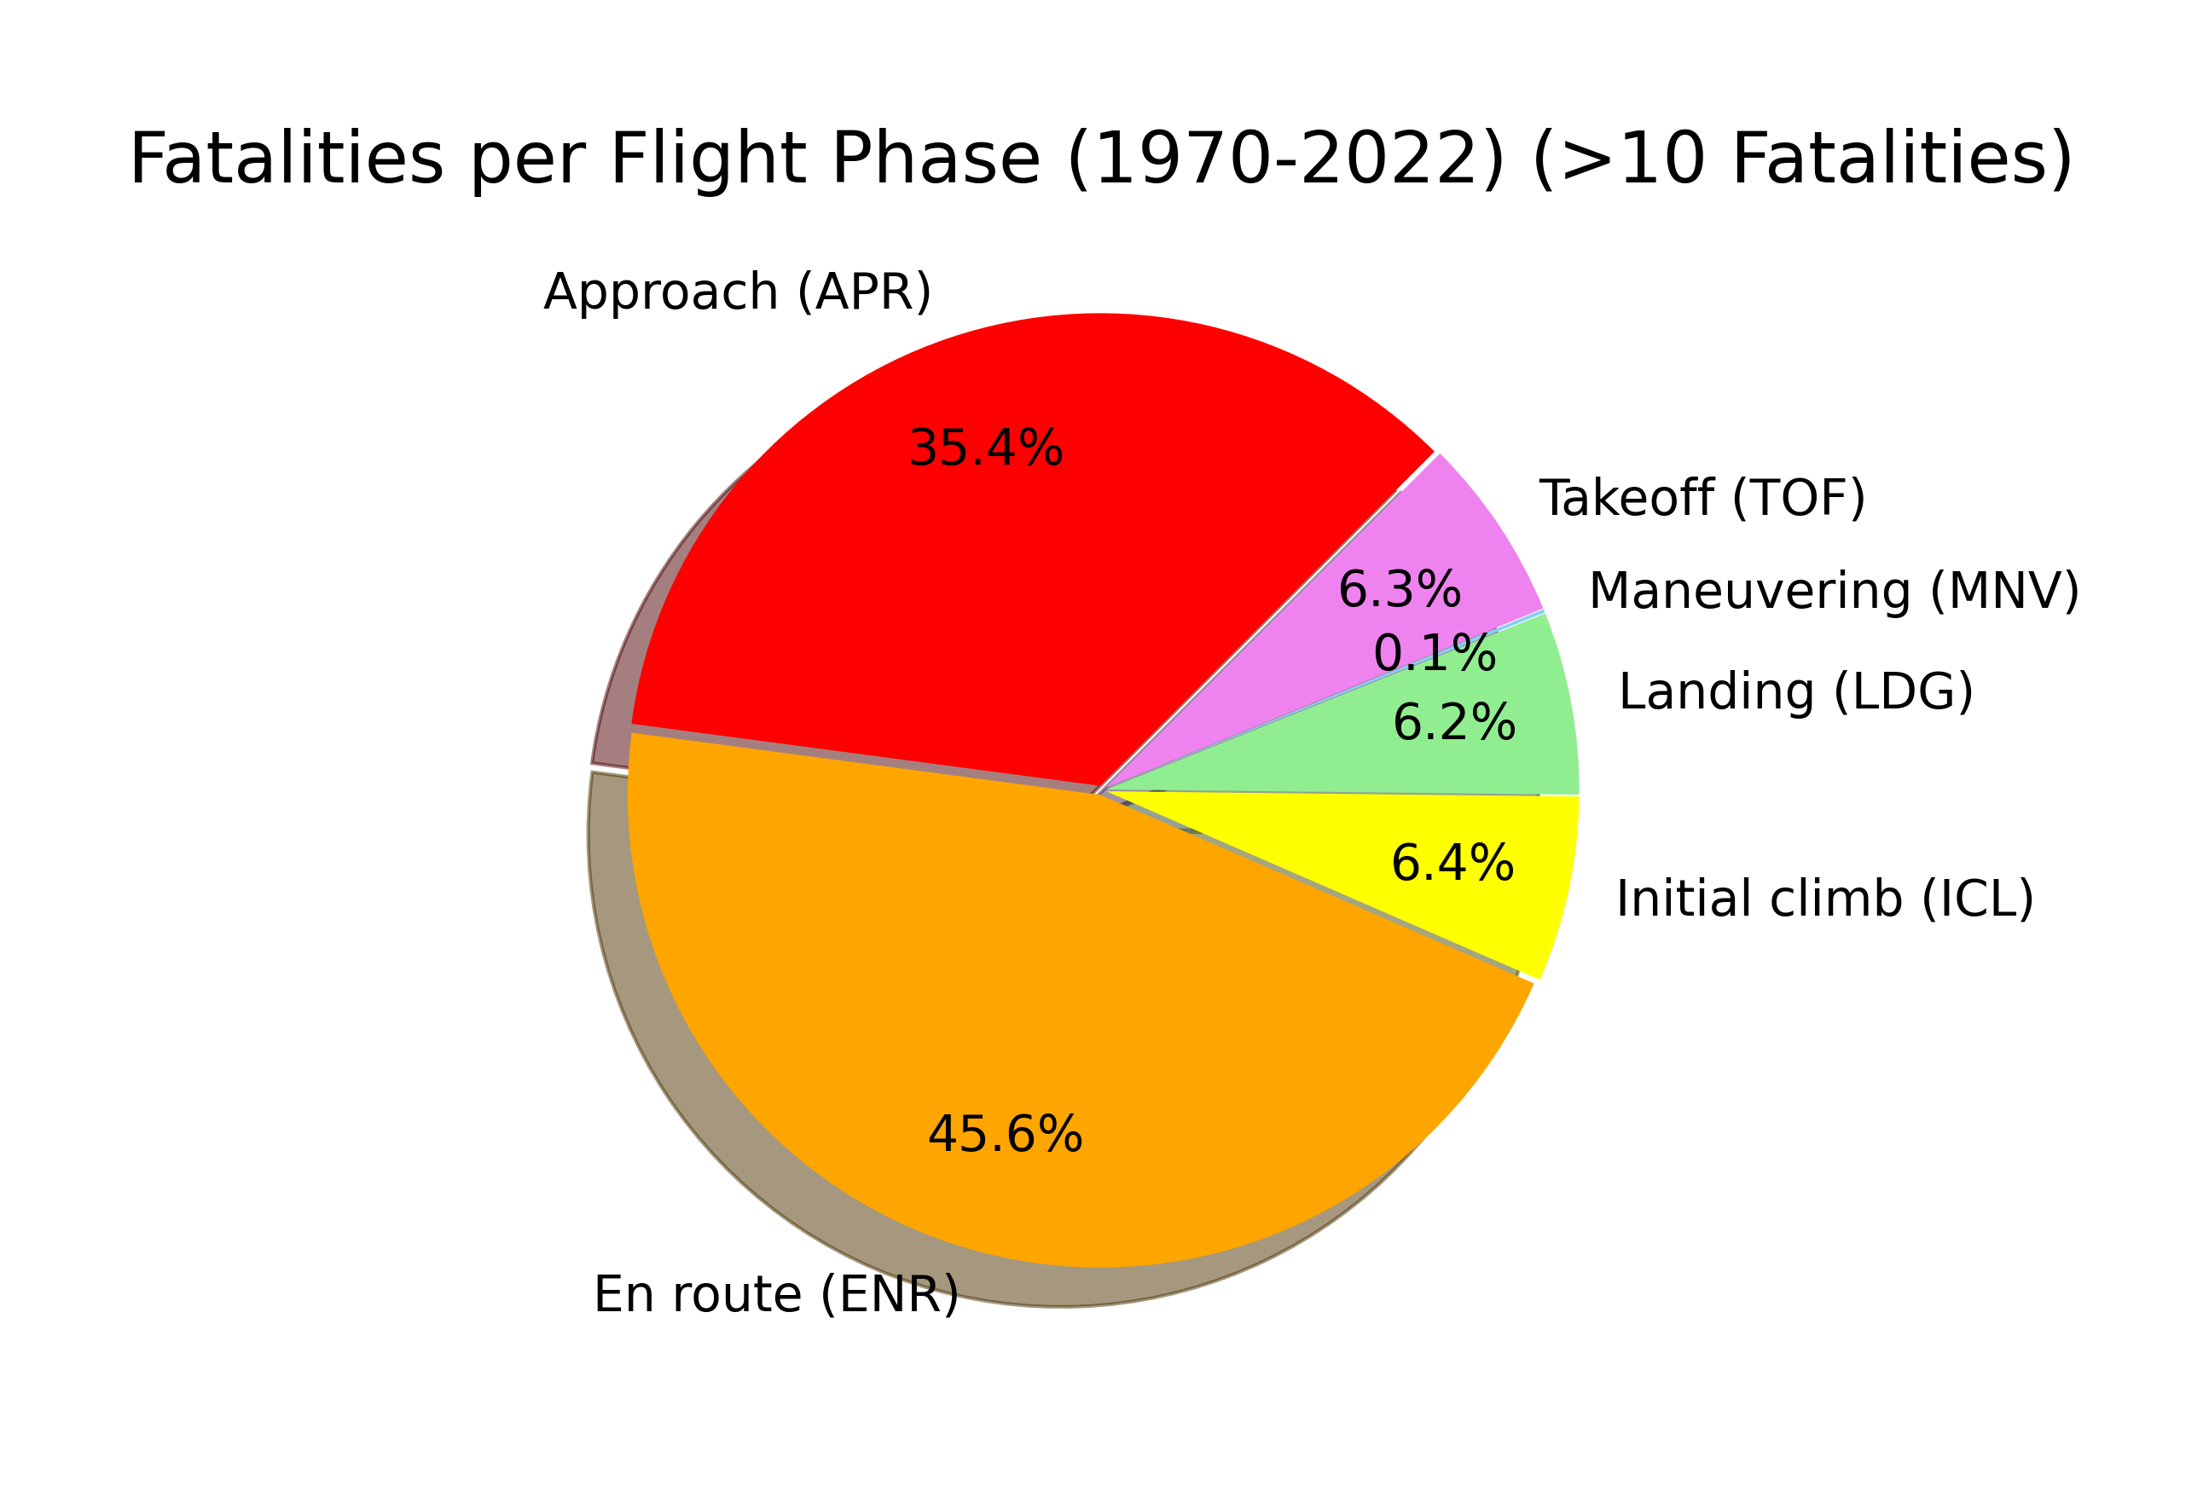
Aviation Accidents Visualization
Analysis:

Slide 14
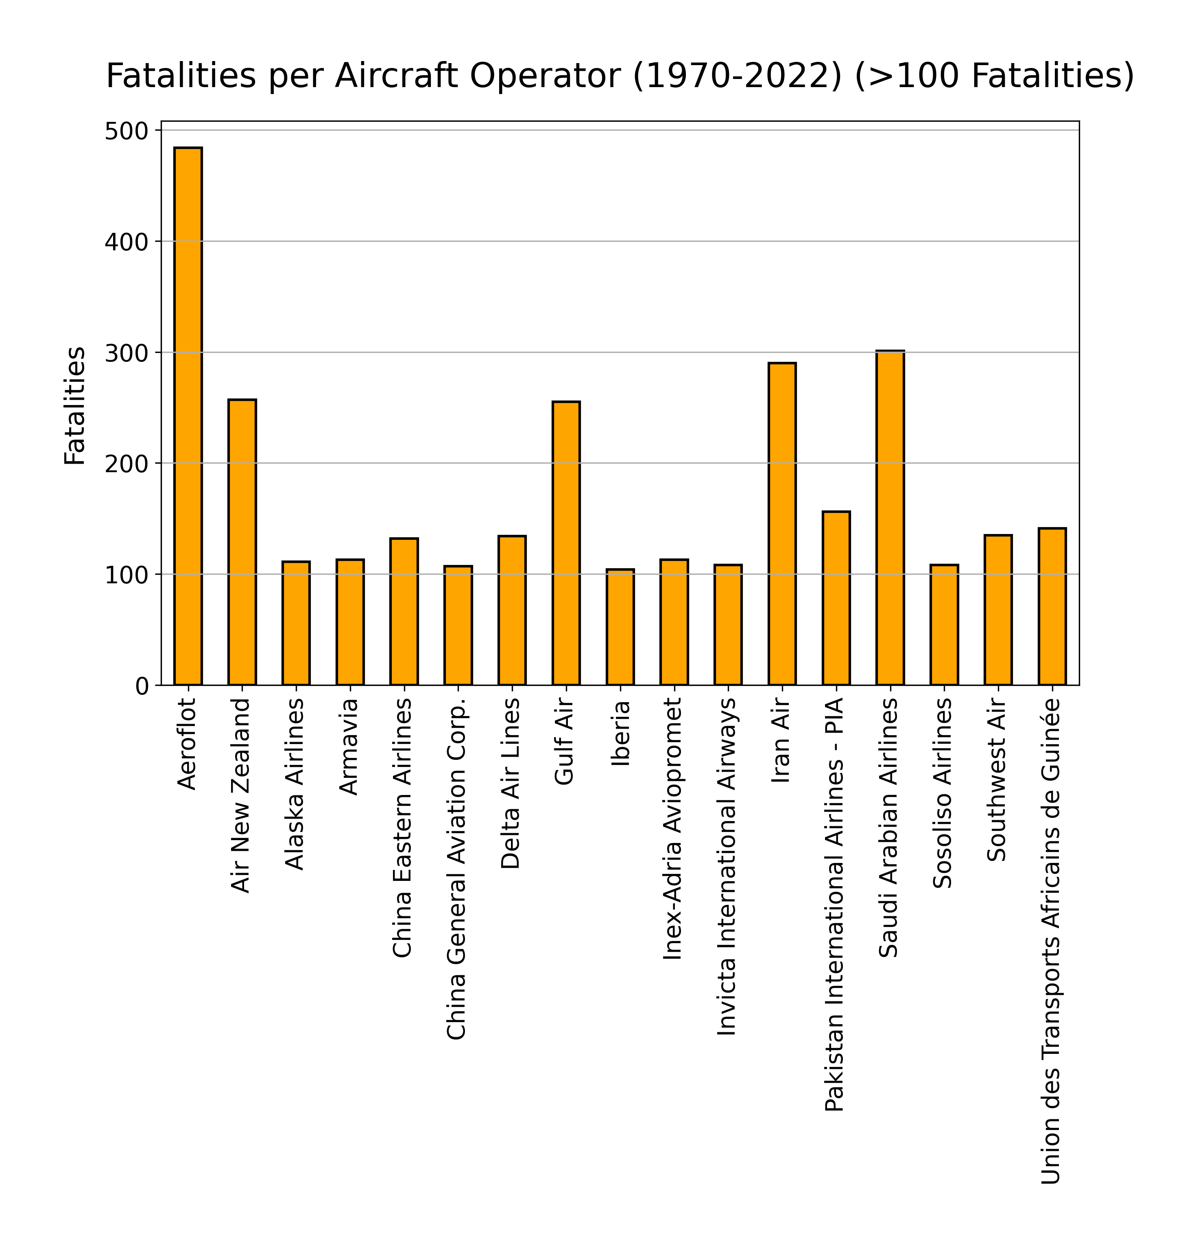
Aviation Accidents Visualization
Analysis:

Slide 15
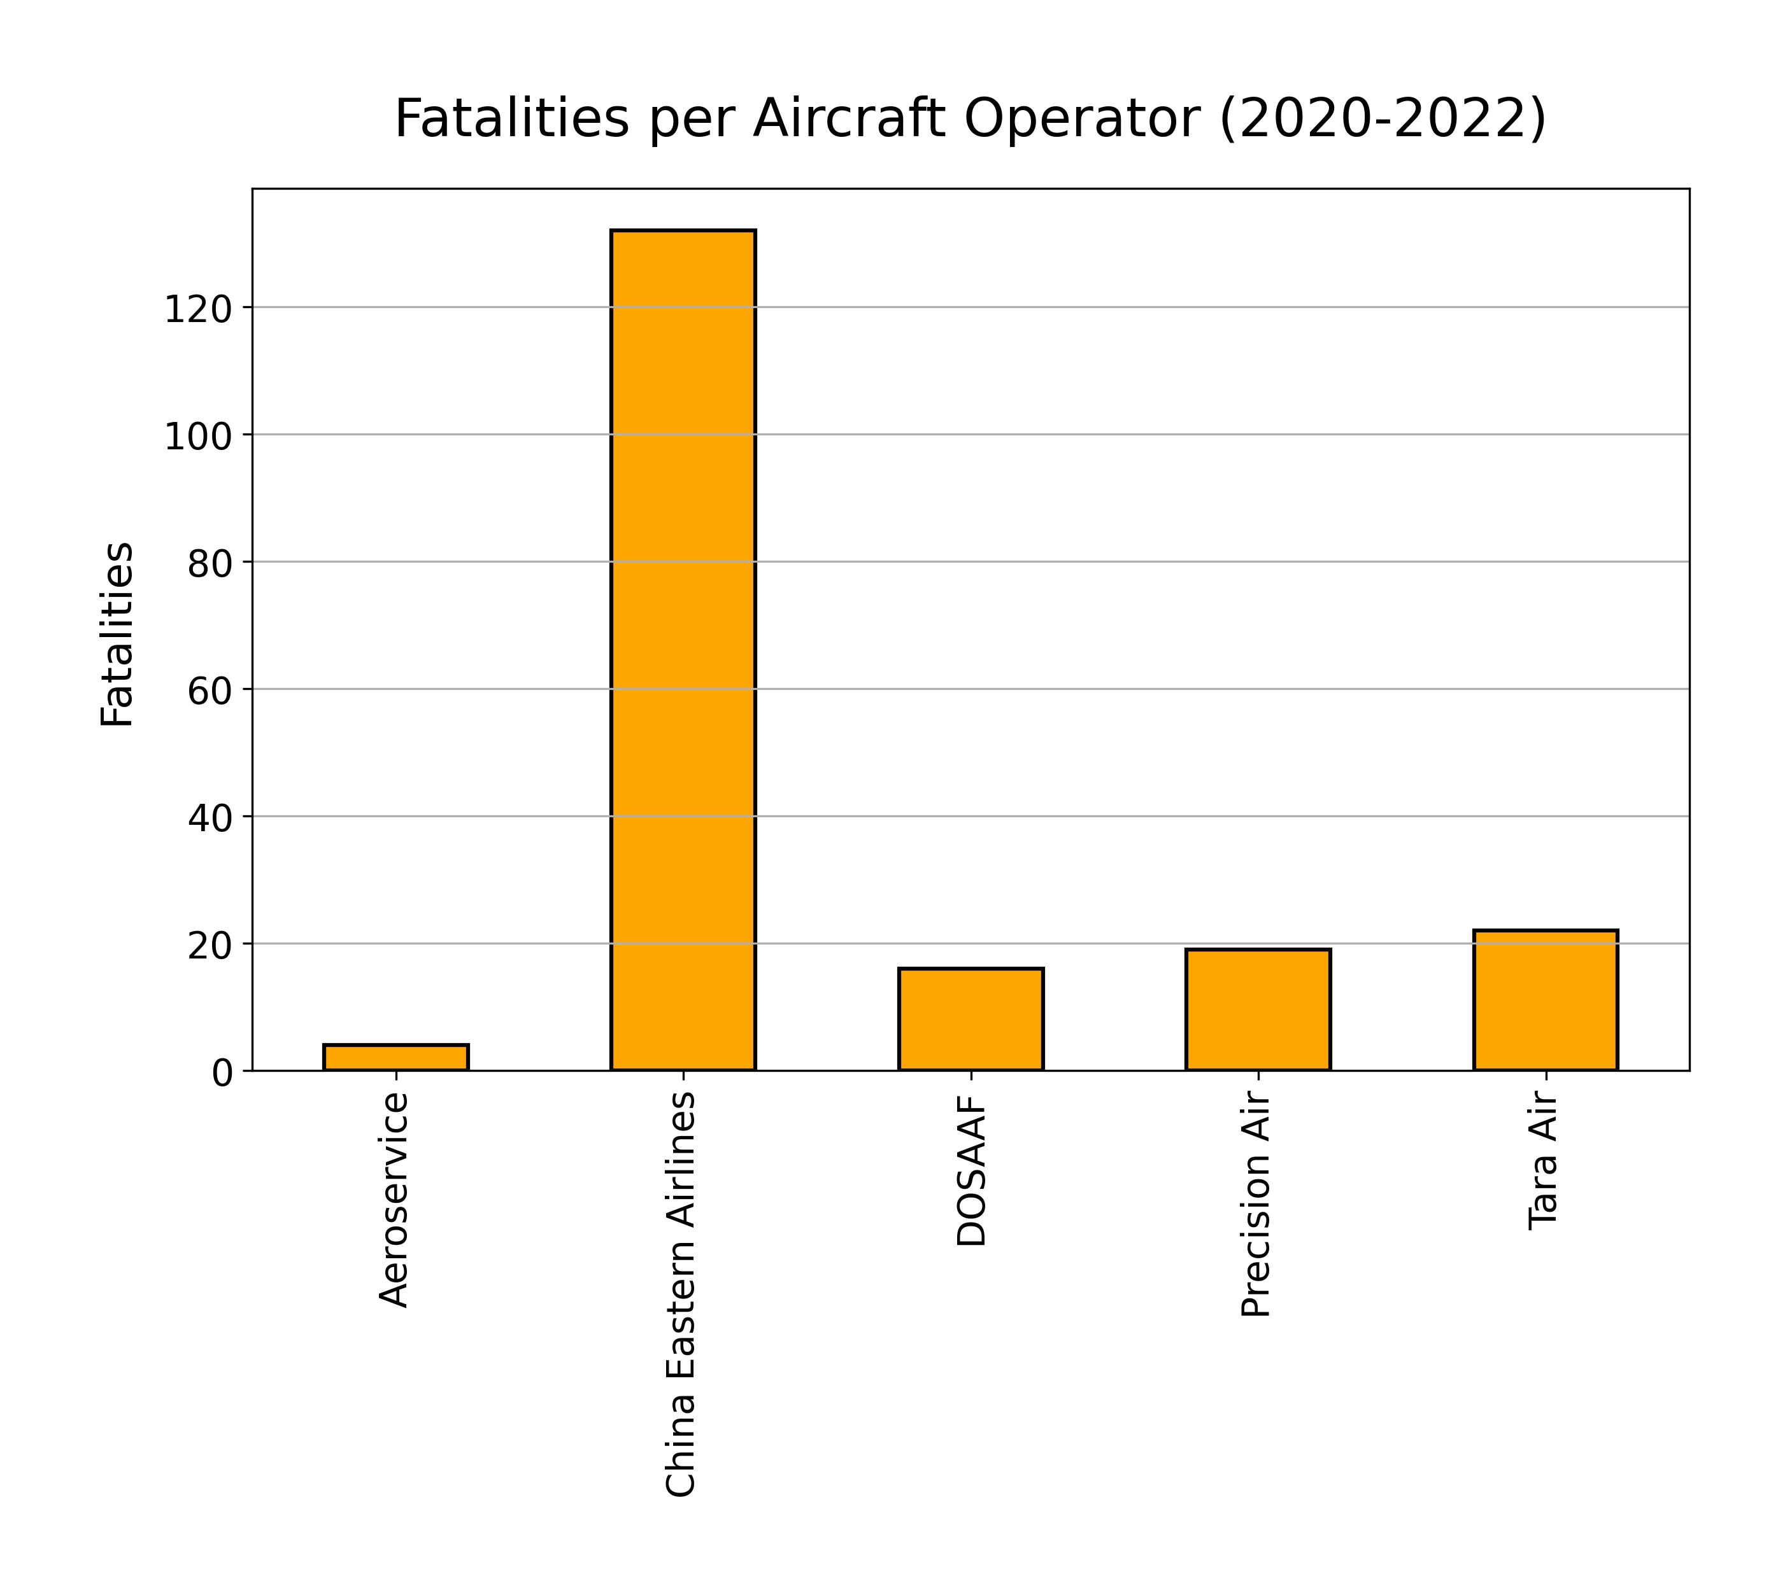
Aviation Accidents Visualization
Analysis:

Slide 16
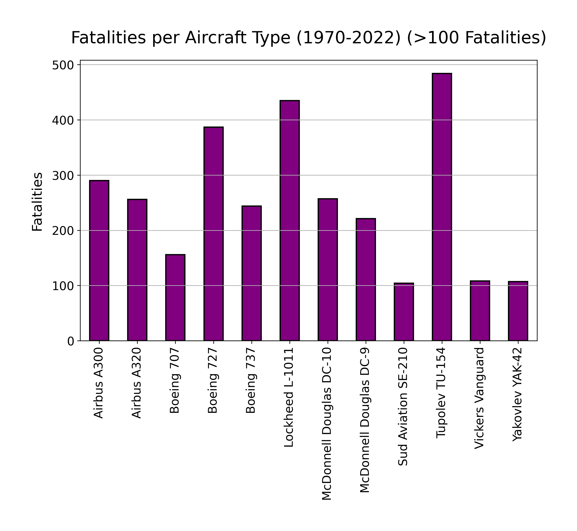
Aviation Accidents Visualization
Analysis:

Slide 17
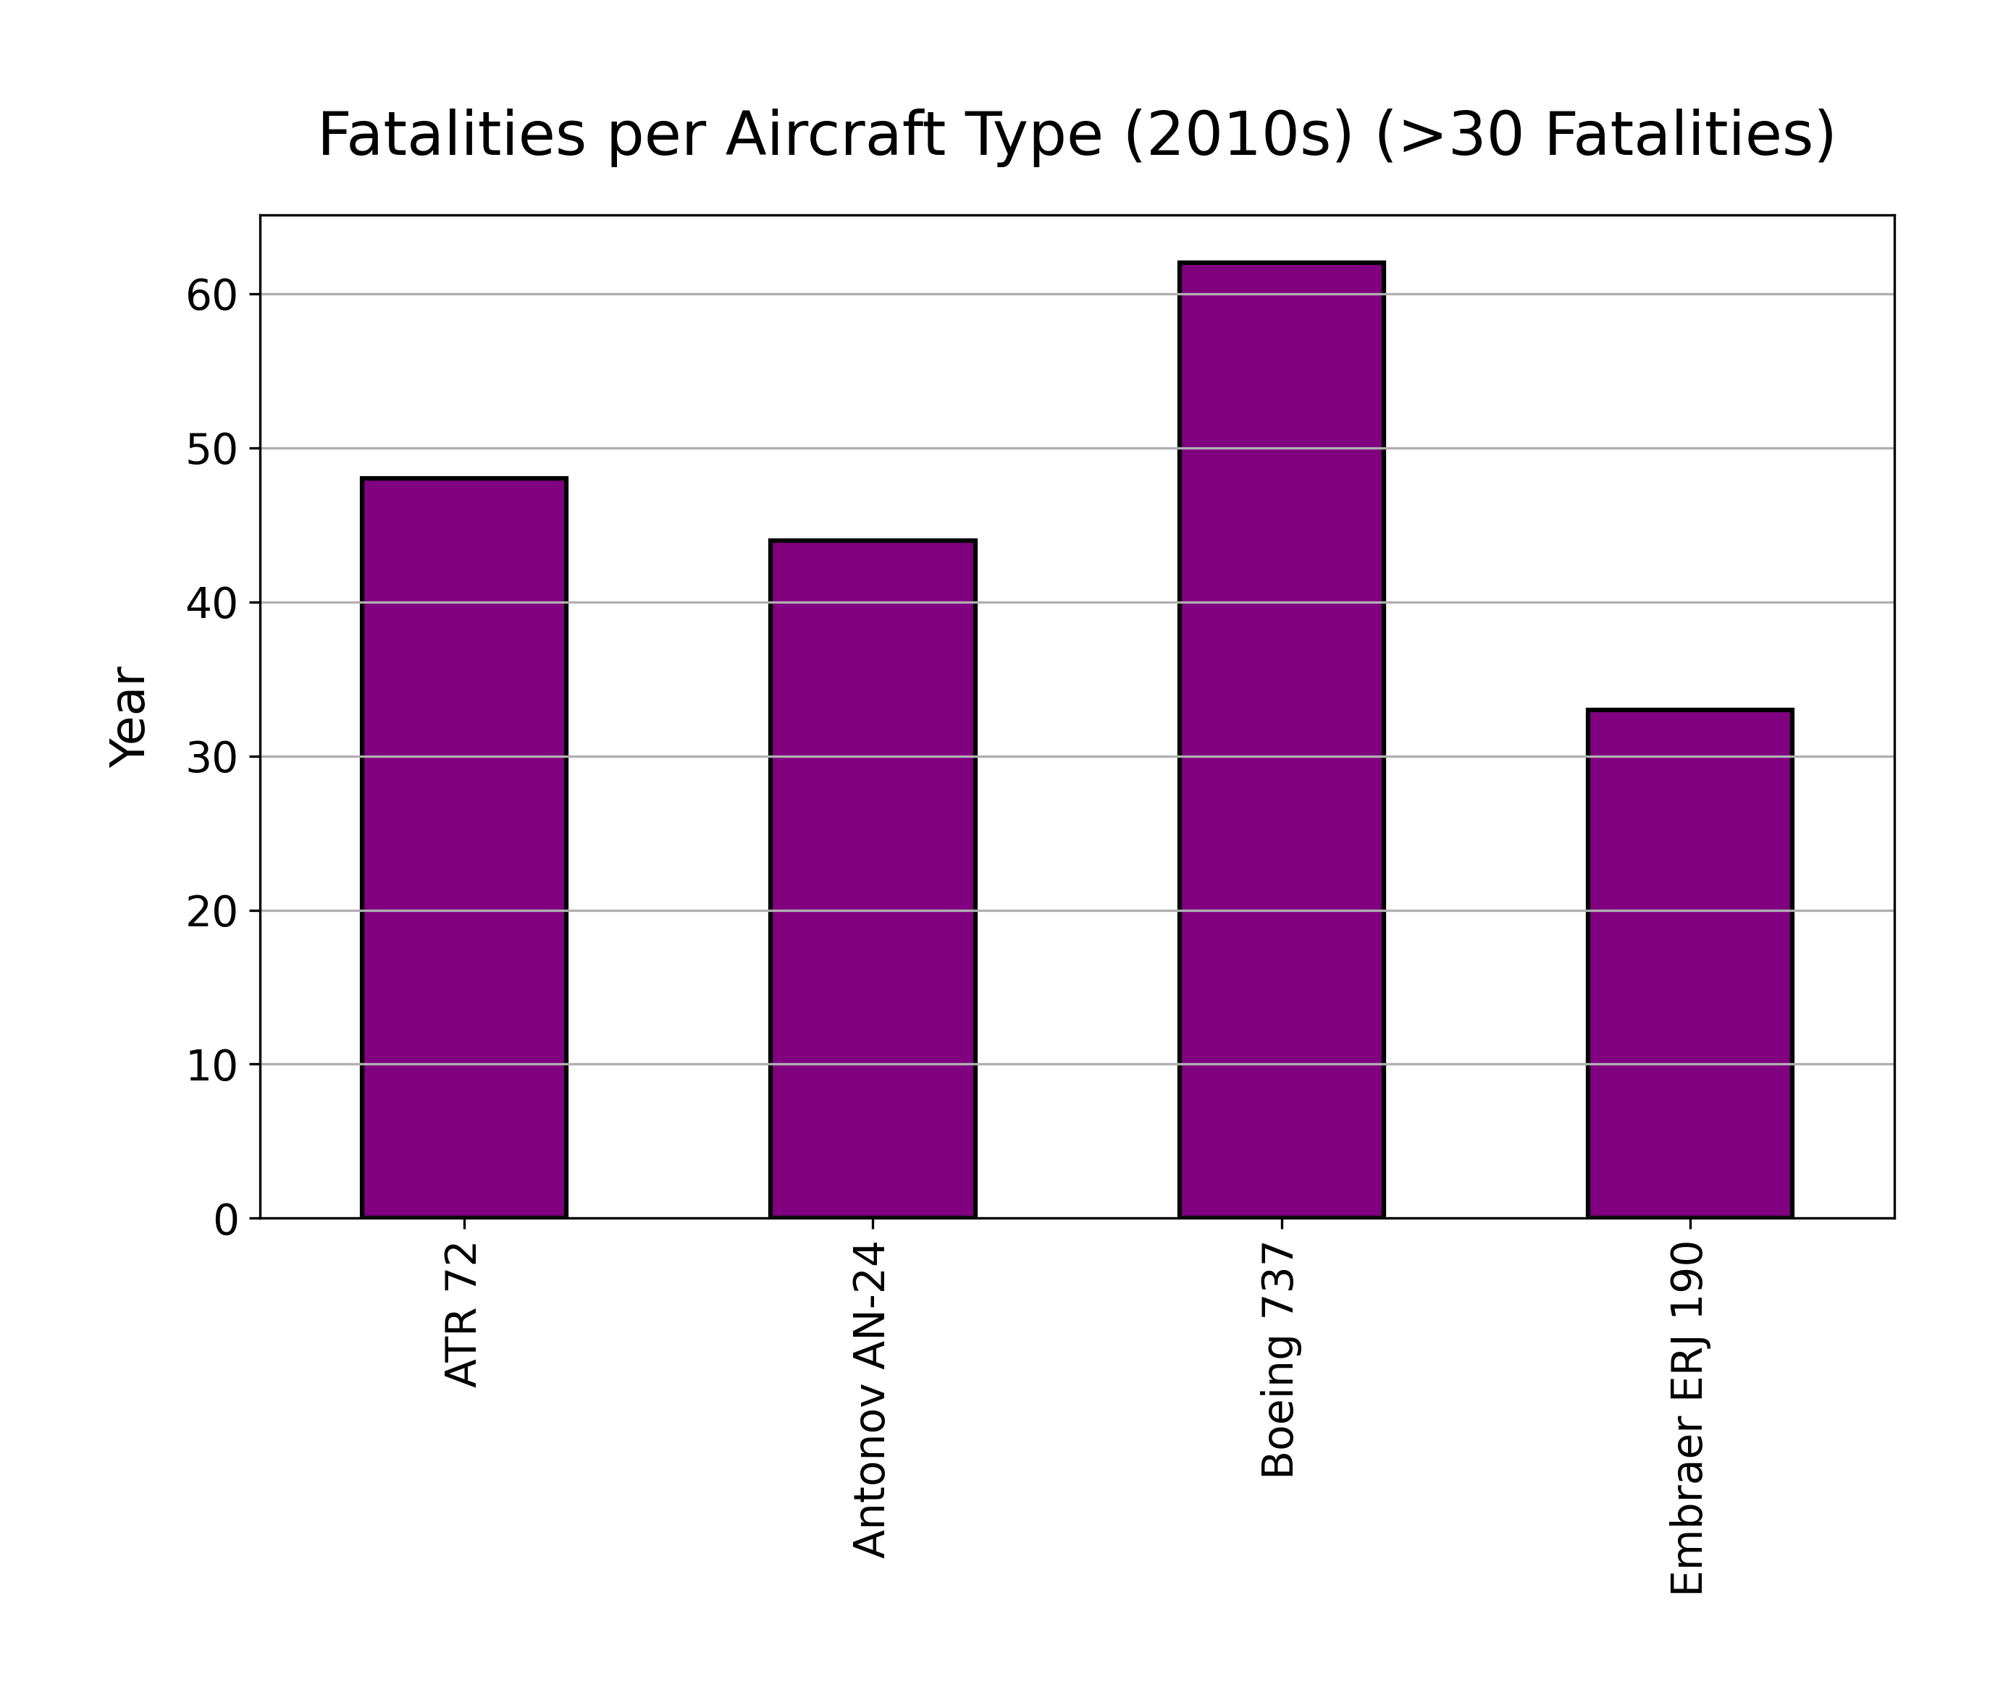
Aviation Accidents Visualization
Analysis:

Slide 18
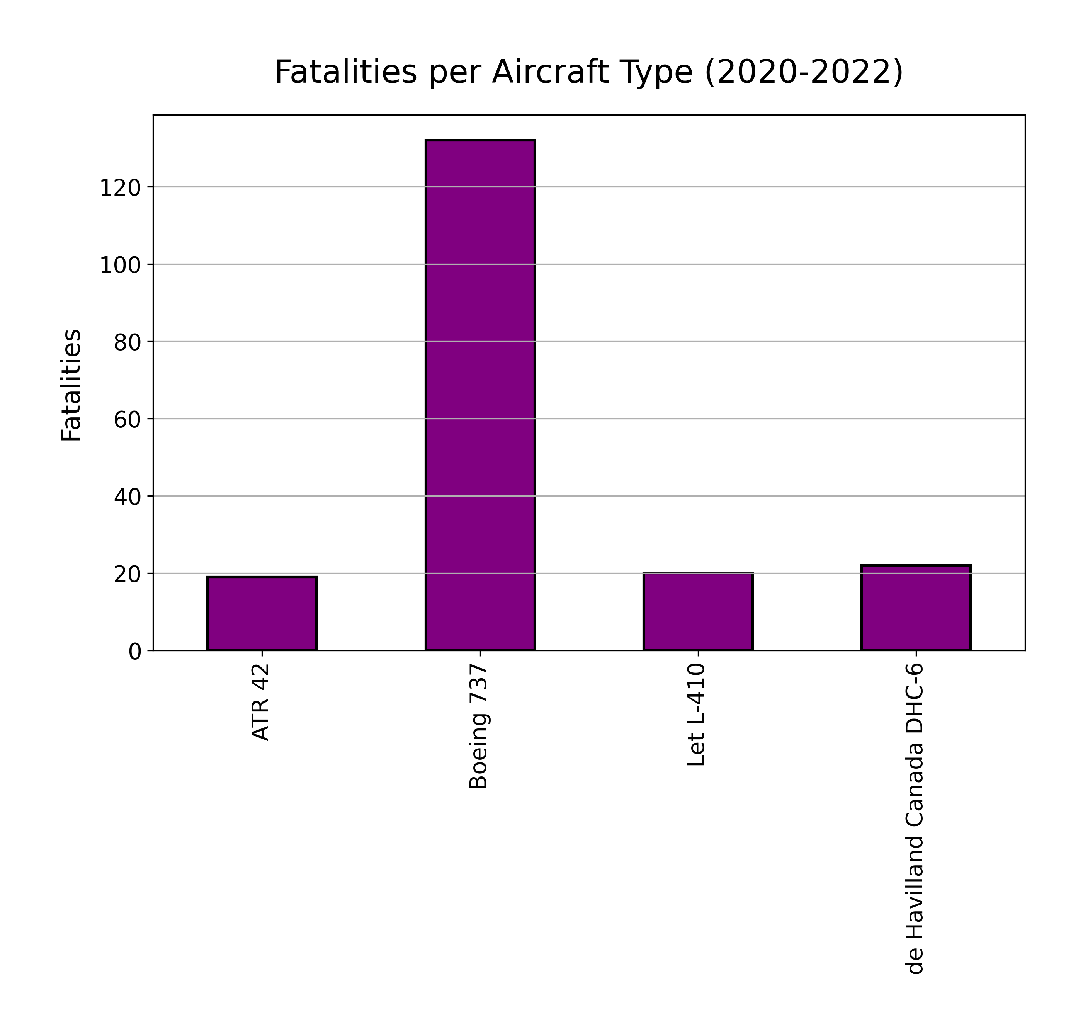
Aviation Accidents Visualization
Analysis:

Slide 19
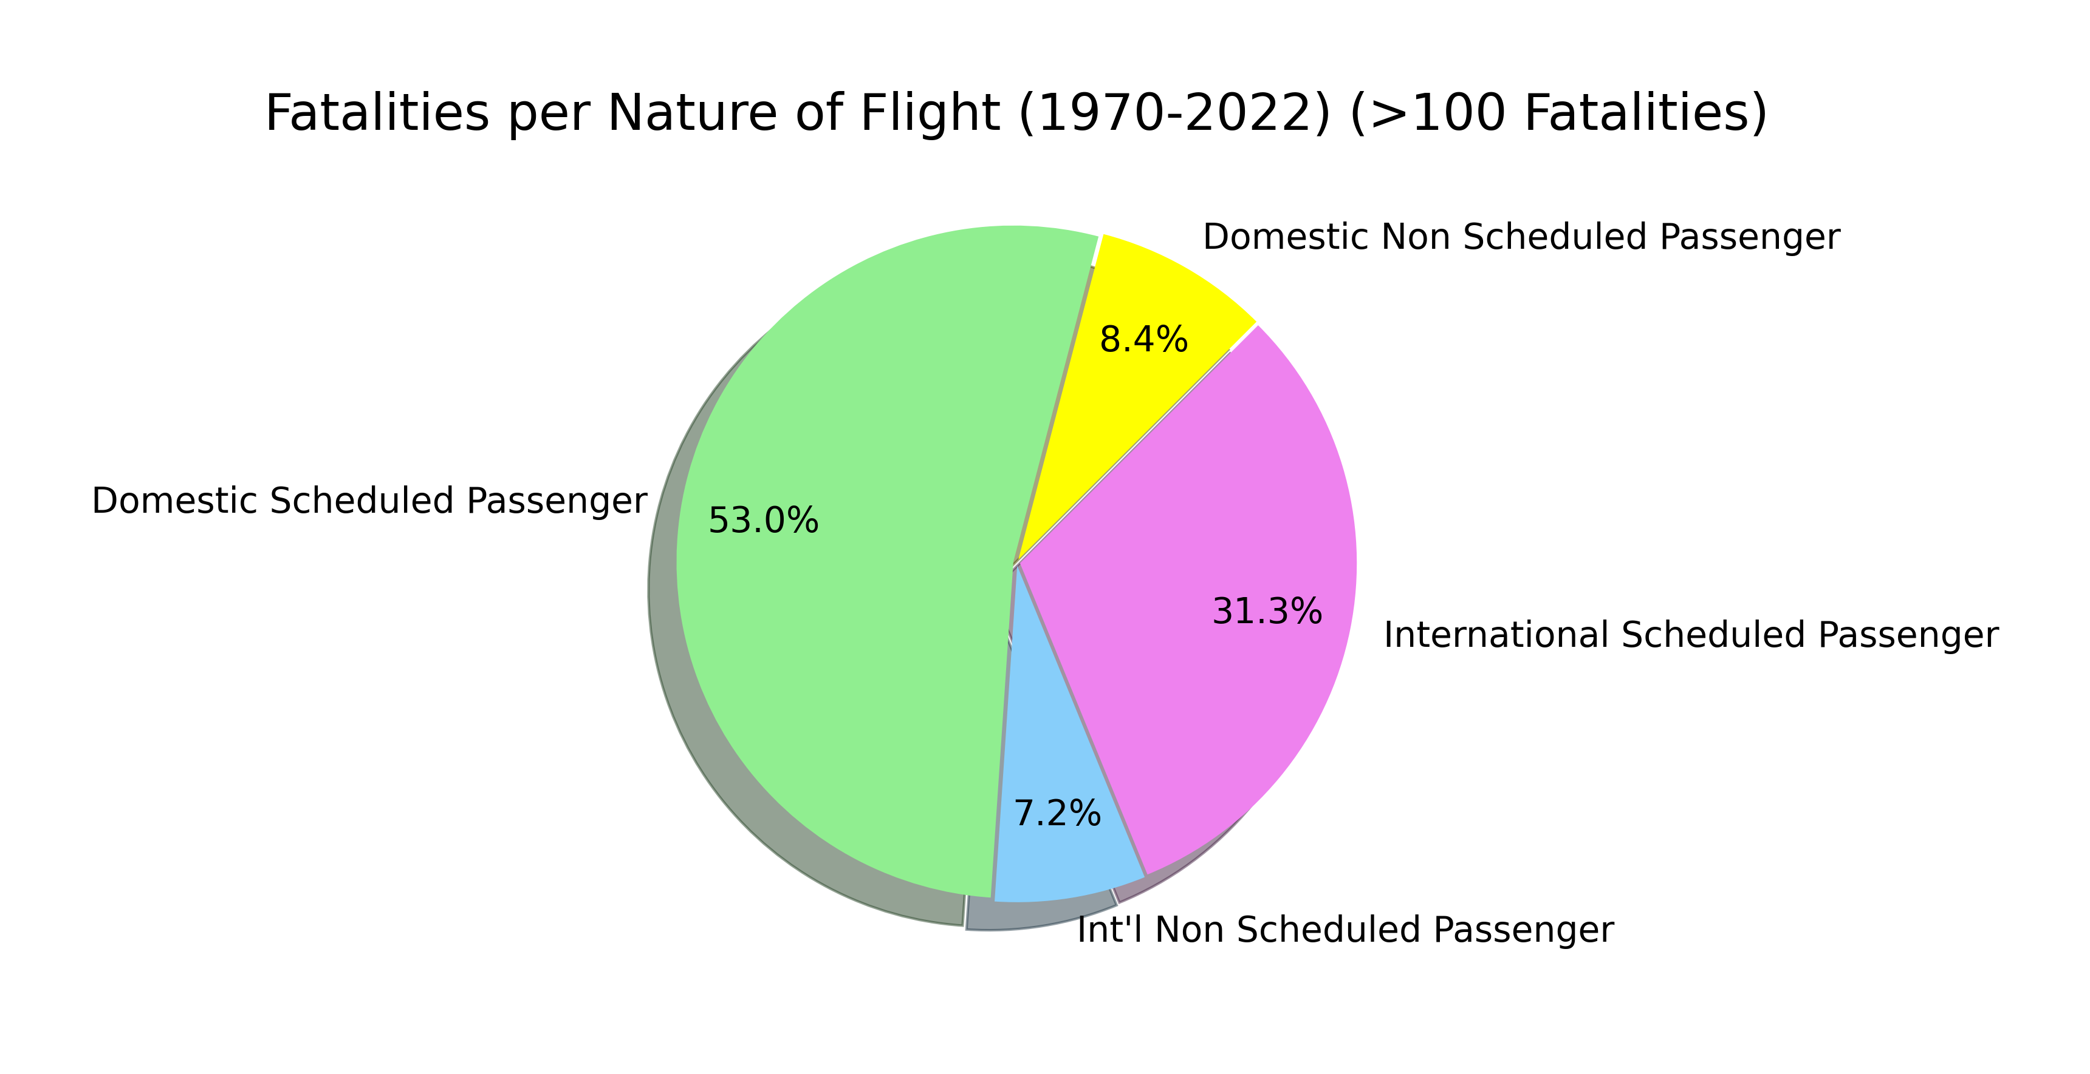
Aviation Accidents Visualization
Analysis:

Slide 20
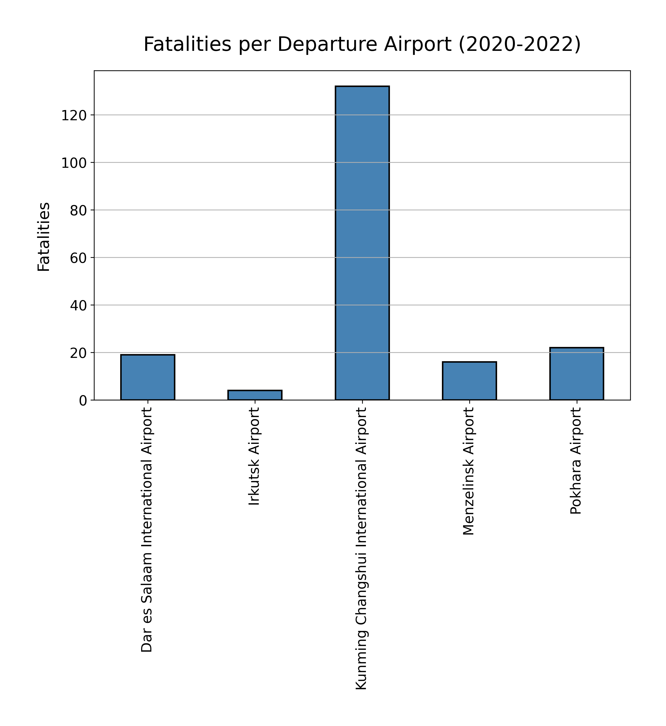
Aviation Accidents Visualization
Analysis:

Slide 21
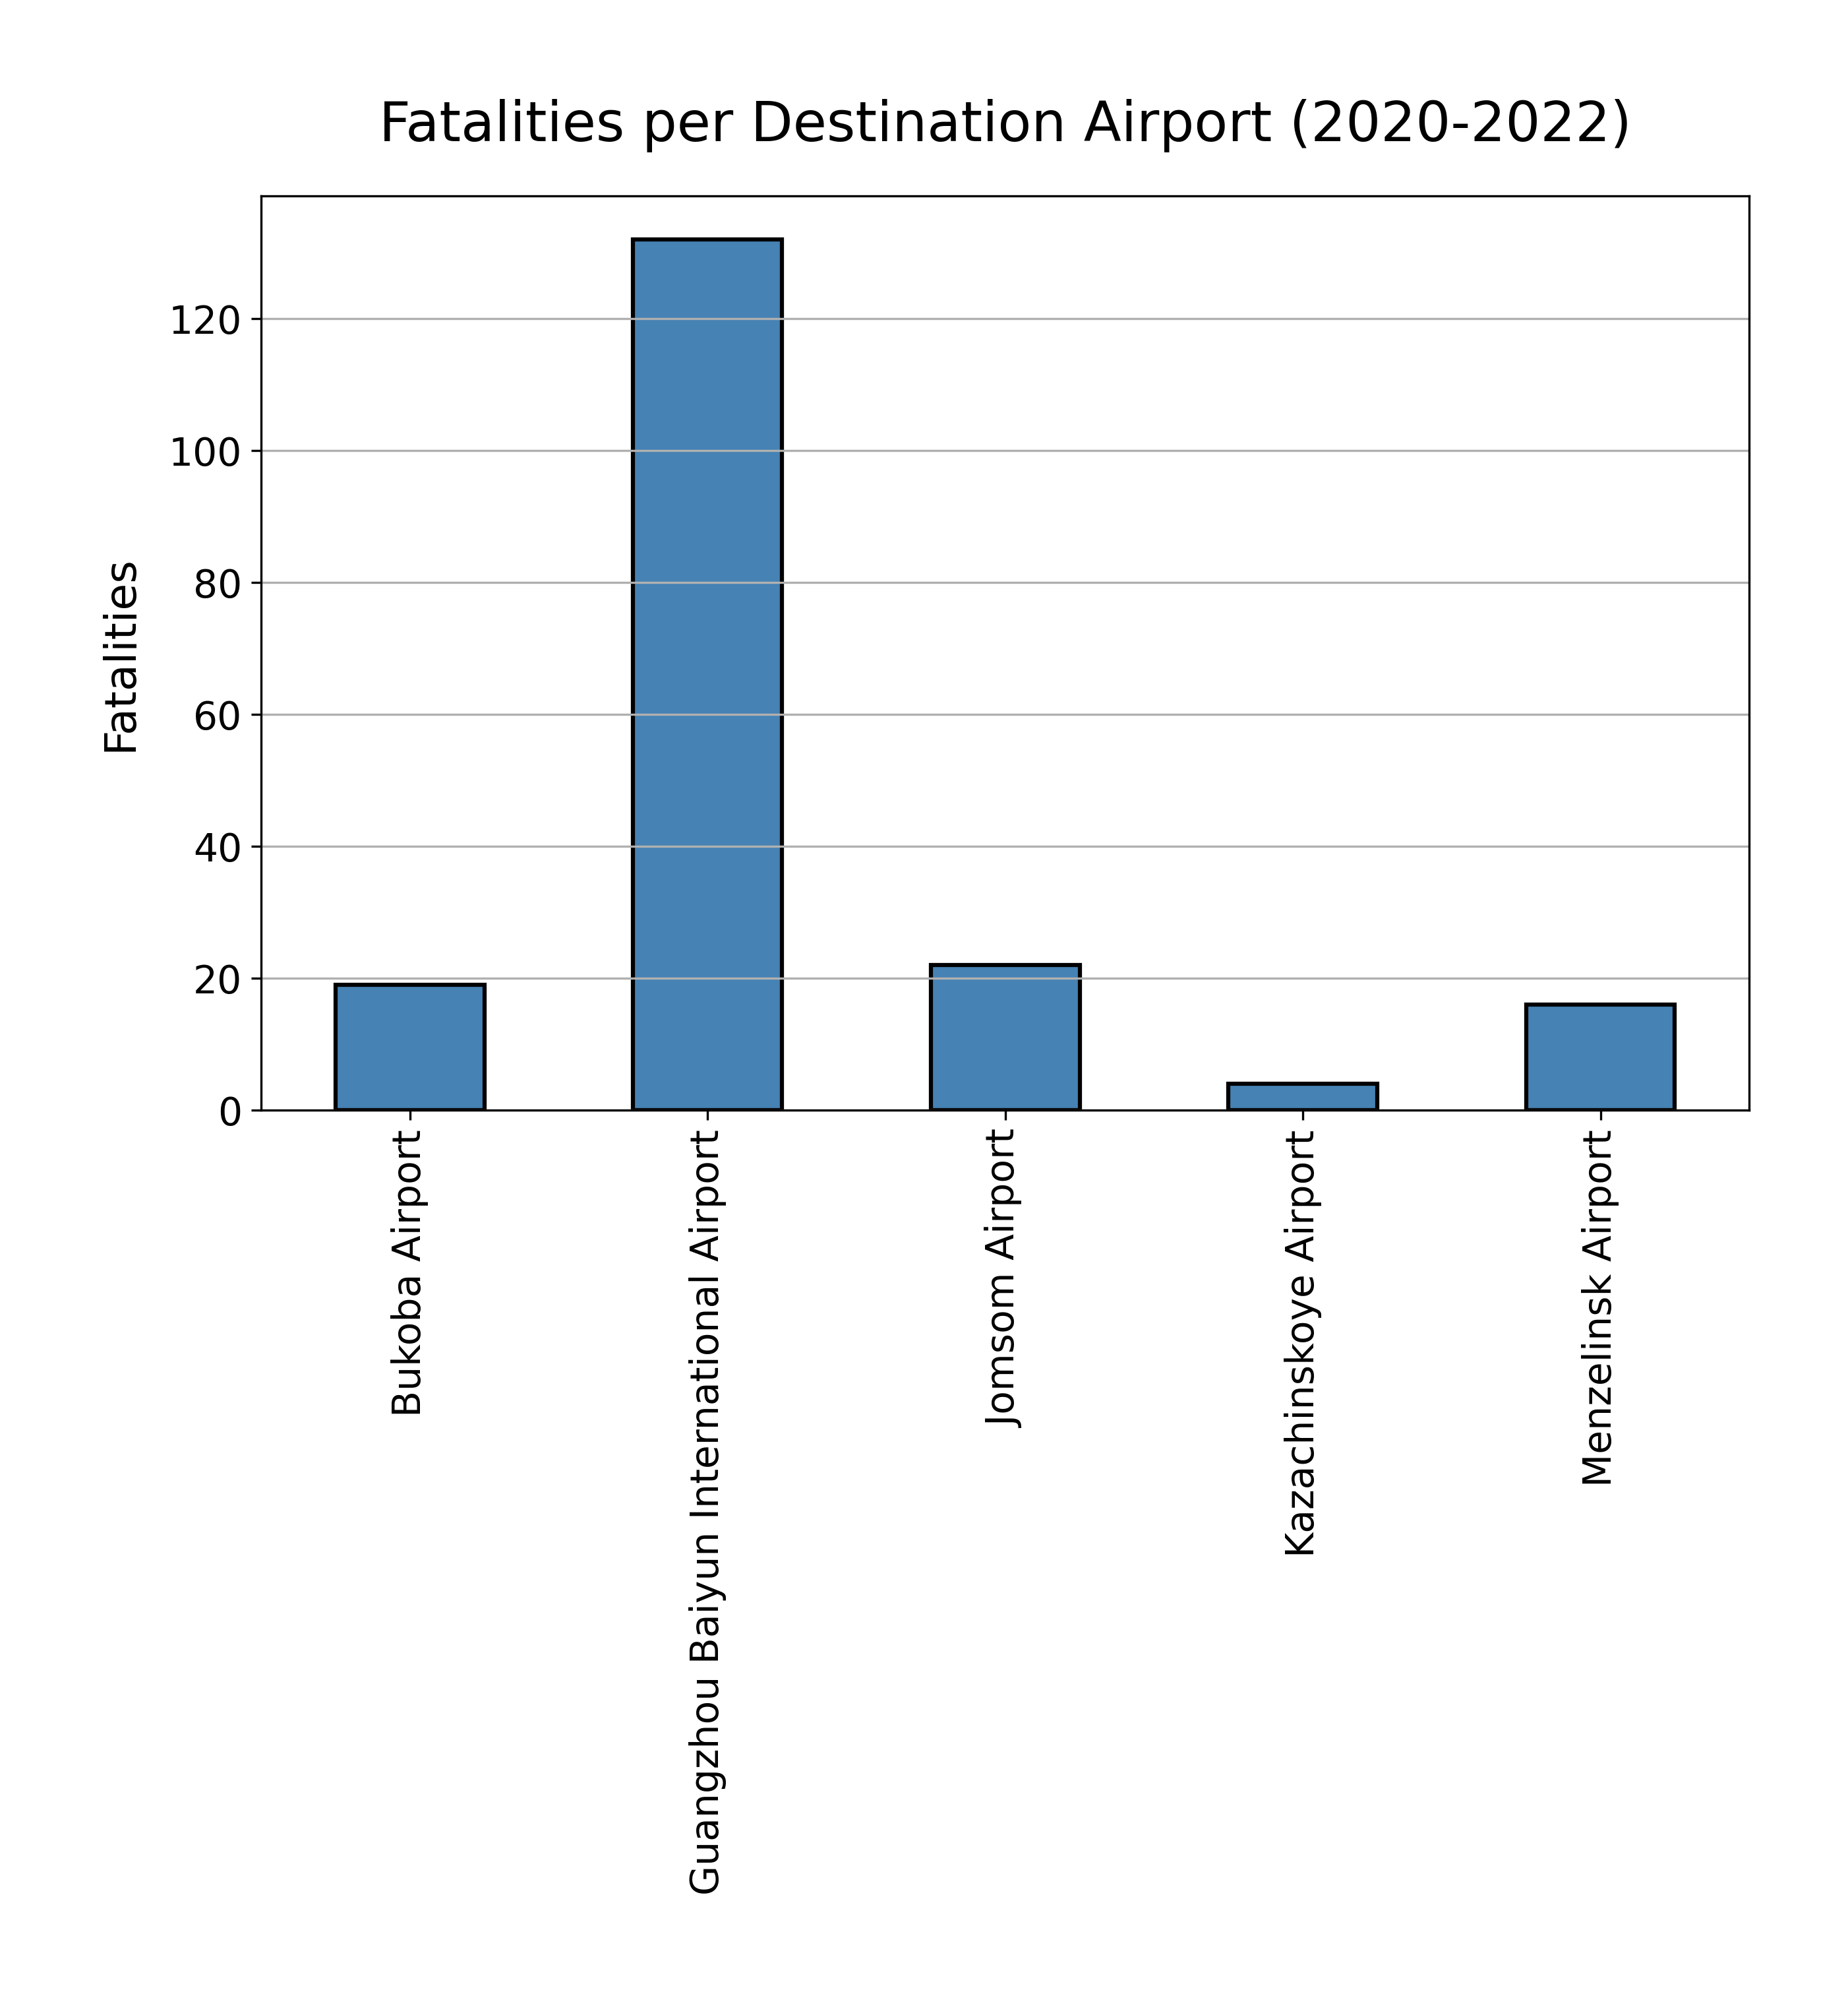
Aviation Accidents Visualization
Analysis:

Slide 22
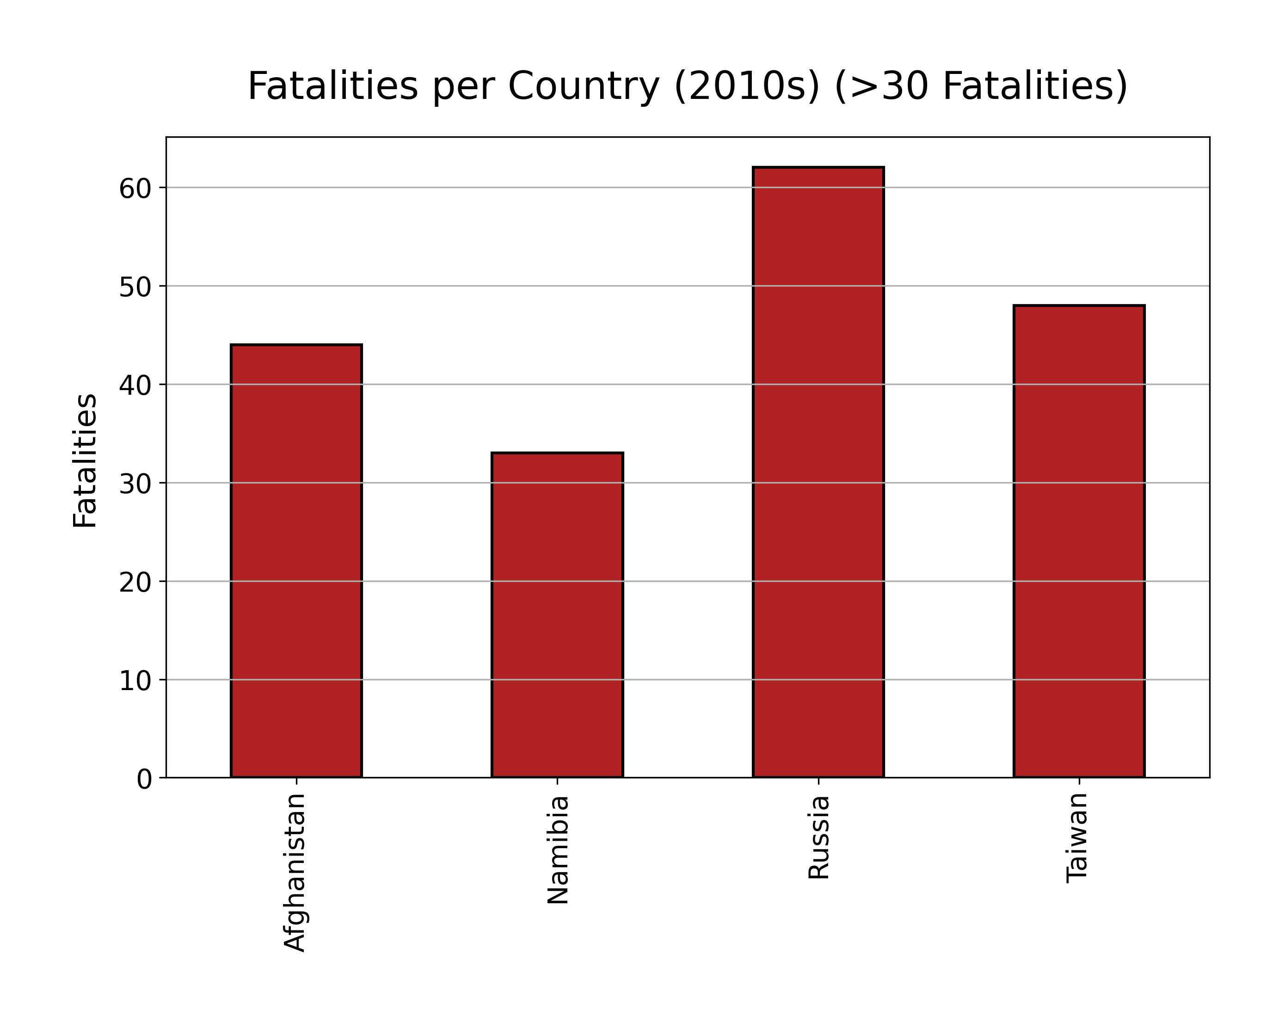
Aviation Accidents Visualization
Analysis:

Slide 23
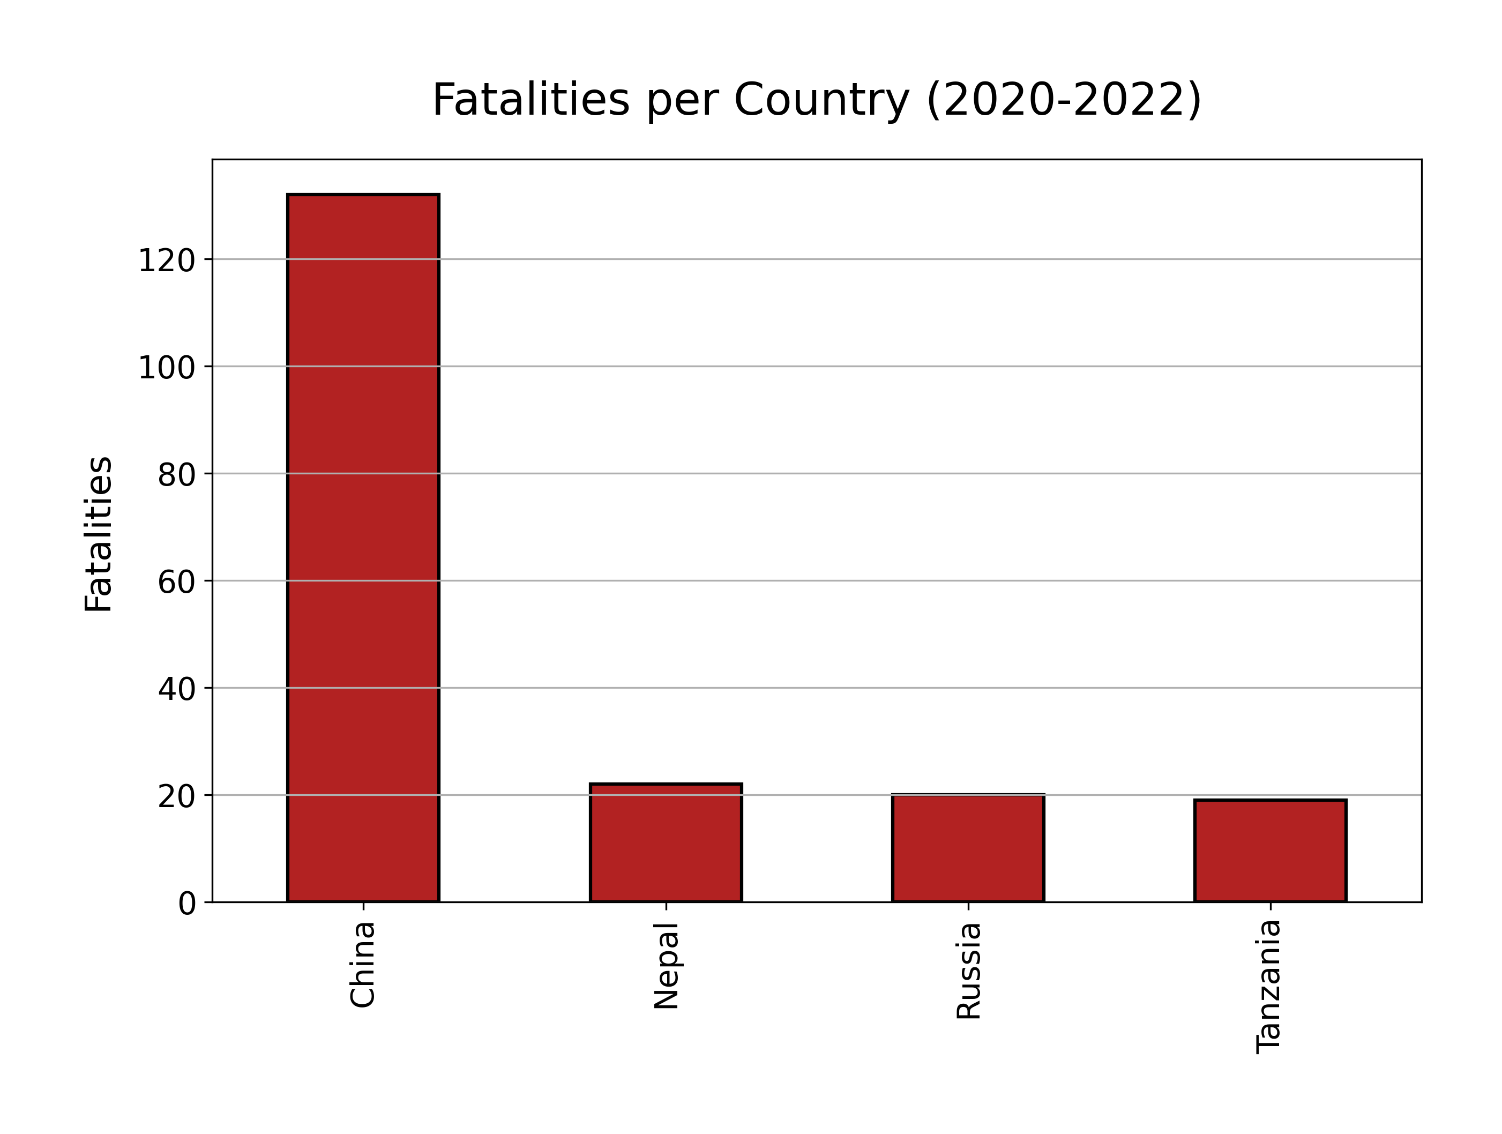
Aviation Accidents Visualization
Analysis:

Slide 24
Aviation Accidents Visualization
Conclusion:
We cannot accurately predict the location of plane crashes only the likelihood based on past events and those parameters change from decade to decade.
During the last few years, China Eastern Airlines has experienced the highest number of fatalities.
Possible outside factors for aviation fatalities include terrorism, political upheaval, and cultural practices.
In any case, the next China Eastern Airlines domestic passenger flight from Kunming Changshui International Airport to Guangzhou Baiyun International Airport on a Boeing 737 should likely be avoided.
This project is a positive first step toward understanding aviation accidents, and, in the future, these fatalities should be compared with total flight data to render percentages as the metric for a clearer picture of the situation.

Slide 25

Aviation Accidents Visualization
Questions? Comments?

